Slide 1

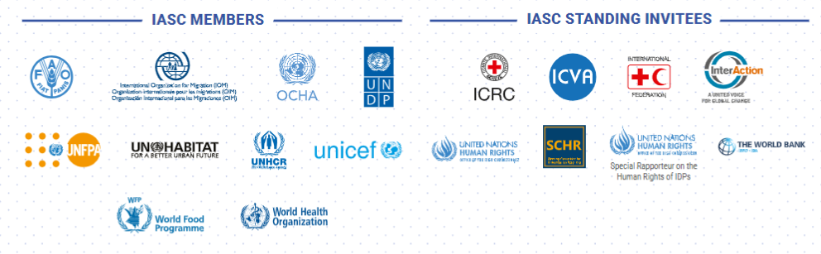




Slide 2

WHAT IS THE iasc?
Established in June 1992 in response to GA resolution 46/182 and reaffirmed by subsequent GA resolutions.​
Primary global coordination mechanism for inter-agency coordination on humanitarian issues.​
​
Only formal UN coordination mechanism that includes non-UN entities.​
​
Led by the Emergency Relief Coordinator to facilitate the leadership role of the UN Secretary-General.​

Slide 3

Outline
Objectives
2022-2024 Strategic Priorities
IASC Structures
Overview of IASC accomplishments

Slide 4
Objectives of the iasc
Strategic decisions on operational issues​
Facilitate an effective, coordinated, collective humanitarian response to crises.​
​
Policy development​
System-wide policies and guidance for humanitarian operations.​
Advocacy​
Platform for the humanitarian community to advocate collectively ​
for common principles and issues. ​
Dialogue​
Forum for dialogue and deliberation on key humanitarian issues.

Slide 5
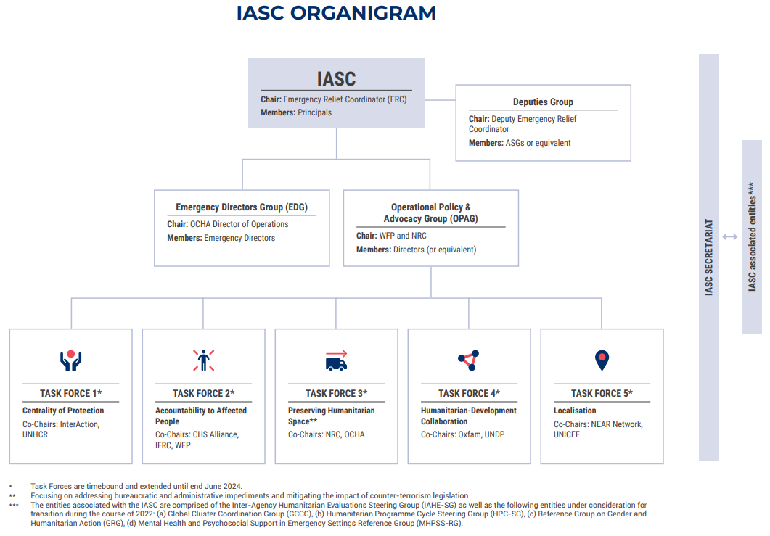
Iasc organigram
page 5

Slide 6
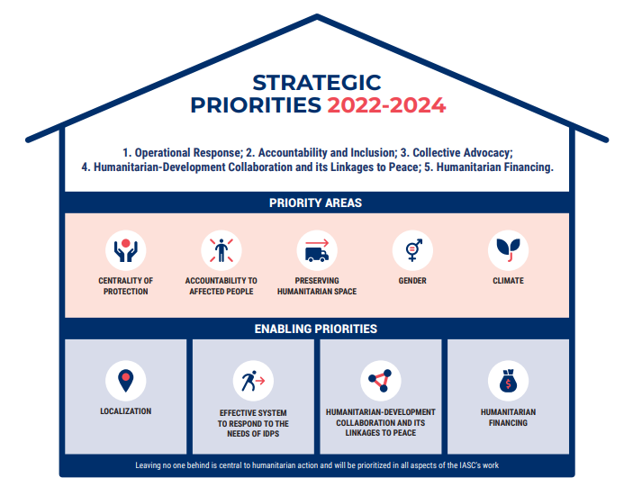
IASC Strategic priorities 2022-2024
page 6

Slide 7
Success criteria
Recognizing that the IASC is, by definition, the Committee of the Principals. As such, IASC structures need to deliver the vision and priorities set by the Committee.
Focusing on results and concrete deliverables – need to demonstrate relevance and effectiveness (leadership + field).
Collaboration – Structures to work well together.
Inclusivity – Need to systematically engage and capitalize on the wealth of knowledge and expertise from non-IASC entities.
Flexibility – Evolve, adapt to the changing global context.
Management – Guidance and support, monitoring, follow-up, accountability, communication/partnerships, by the IASC secretariat.

Slide 8
ACCOMPLISHMENTS
Strengthened and coordinated response to crises (incl. Covid-19) – scale-ups etc.
Stepped up advocacy and humanitarian diplomacy – IASC statements etc.
Strengthened field support (ops, thematics)
Providing normative support to system and field
Putting into practice IASC tools, decisions and policies
Improved system learning
Decisions tracked and monitored for implementation

Slide 9
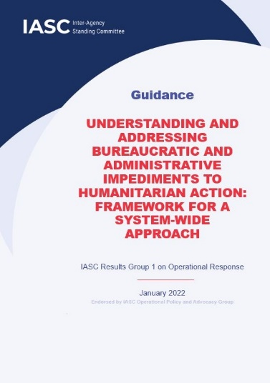

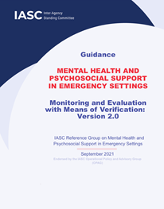
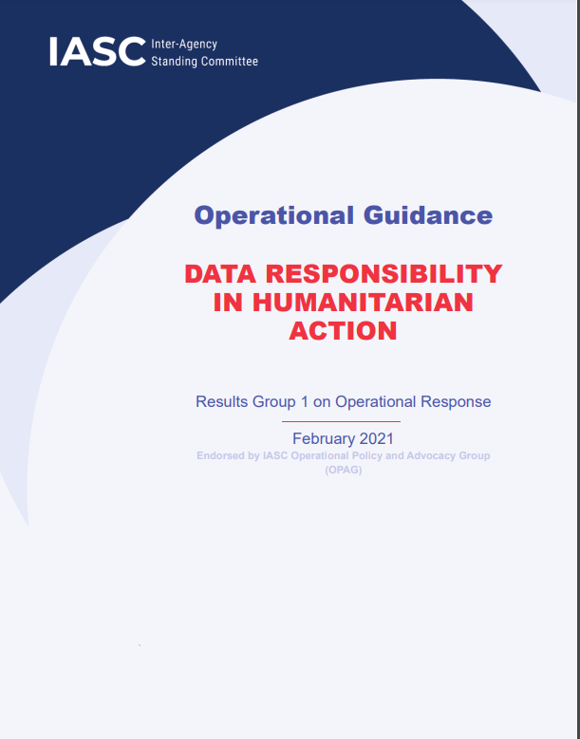
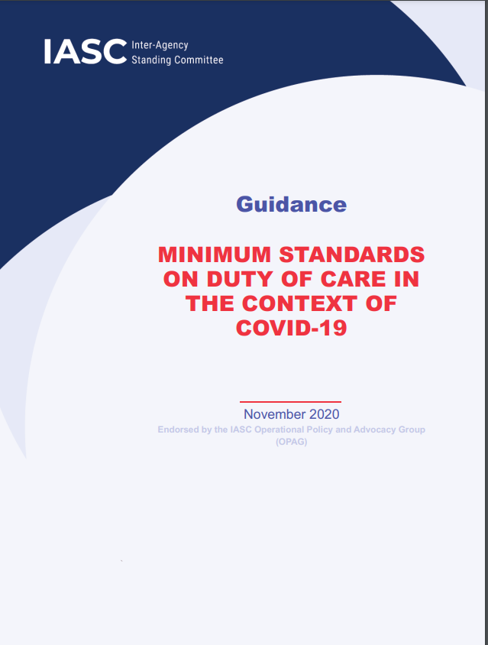
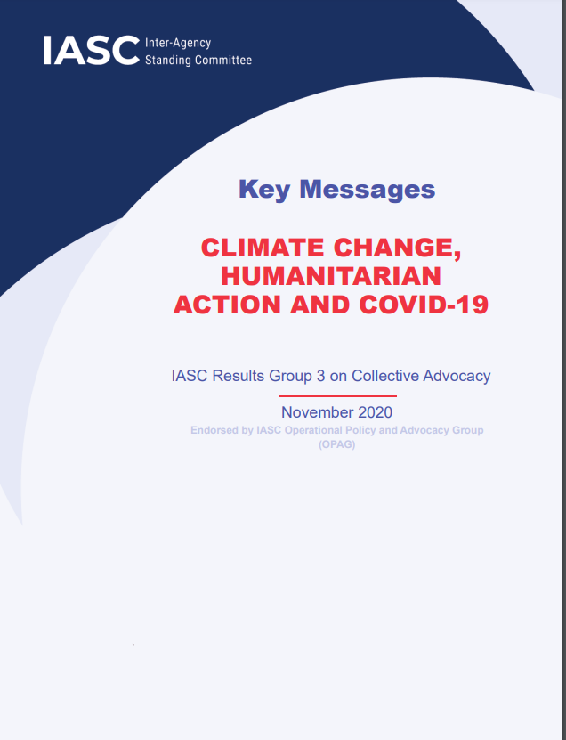

Examples of iasc products
IASC Guidance Understanding and Addressing Bureaucratic and Administrative Impediments to Humanitarian Action: Framework for a System-wide Approach.
IASC Synthesis Report Mapping Good Practice in the Implementation of Humanitarian-Development-Peace Nexus Approaches.
Statement by Principals of the Inter-Agency Standing Committee on Climate.
IASC Guidance on Mental Health and Psychosocial Support in Emergency Settings, Monitoring and Evaluation with means of verification (Version 2.0).
Statement by Principals of the Inter-Agency Standing Committee on Afghanistan.
IASC Operational Guidance on Data Responsibility in Humanitarian Action.
IASC Guidance on Minimum Standards on Duty of Care in Context of COVID-19.
IASC Key Messages on Climate Change, Humanitarian Action and COVID-19
All accessible on the IASC website: https://interagencystandingcommittee.org/resources/iasc-products

Slide 10
Thank you.
www.interagencystandingcommittee.org
Twitter: @iascch | LinkedIn: inter-agency-standing-committee-iasc | Facebook: FriendsofIASC

