Slide 1
Inter-Agency Standing Committee Principals Meeting 17 December 2013
If we don't change our direction we're likely to end up where we're headed
Chinese proverb

Slide 2
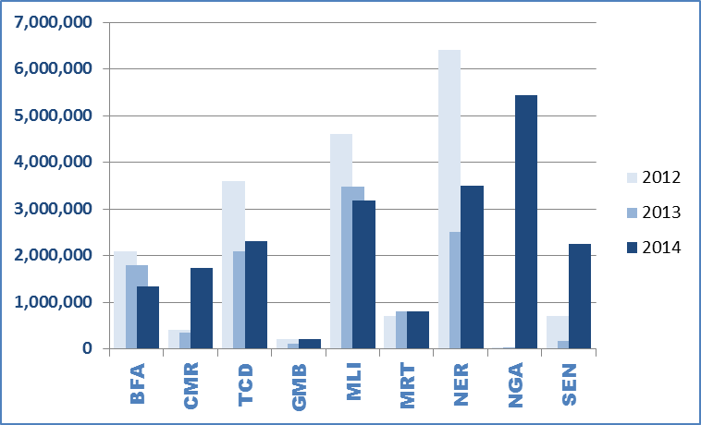
Food insecurity (2012-2014)
2012: 18.7 million
2013: 11.3 million
2014: 20.6 million

Slide 3
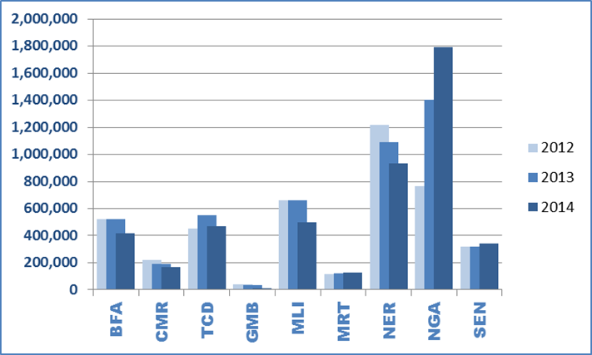
Global Acute Malnutrition (2012-2014)
2012: 4.31 million
2013: 4.89 million
2014: 4.75 million

Slide 4
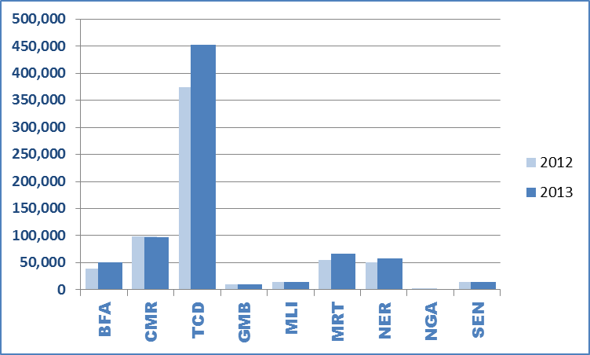
Refugees in the Sahel (2012-2013)
2012: 658,148
2013: 764,923

Slide 5
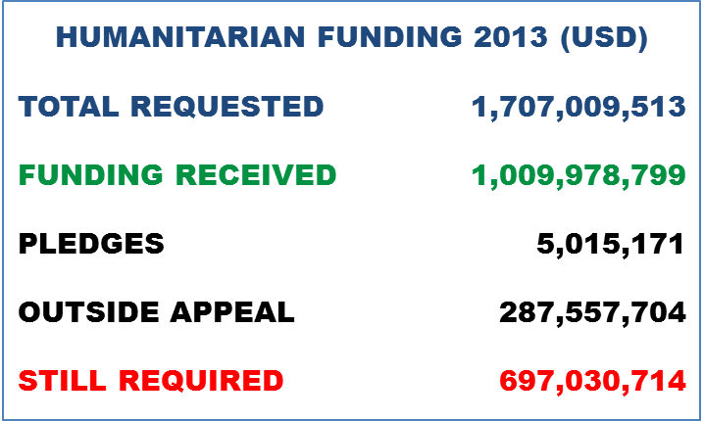
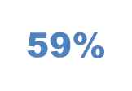
Sahel Humanitarian Funding 2013

Slide 6
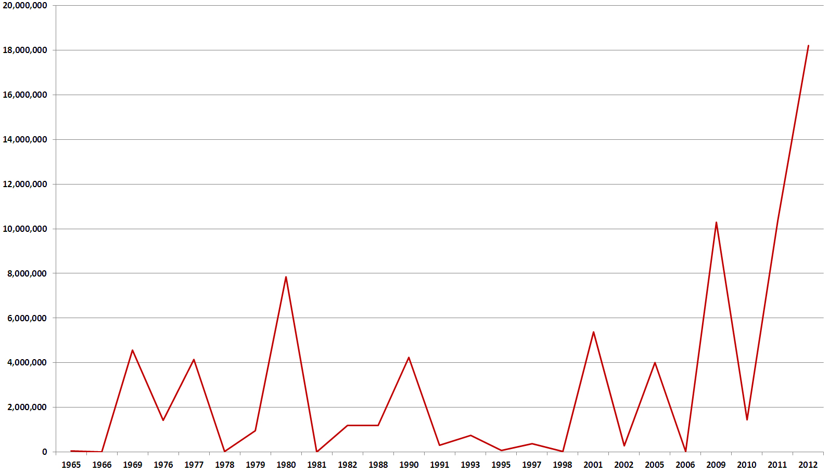
Number of people affected by drought in 6 Sahel countries (1965-2011)
Source: USAID Sahel Joint Planning Cell (JPC)
Six Countries: Mauritania, Mali, Burkina Faso, Niger, Senegal and Chad

Slide 7
Sahel humanitarian needs 2004 - 2013
2005
drought

Slide 8
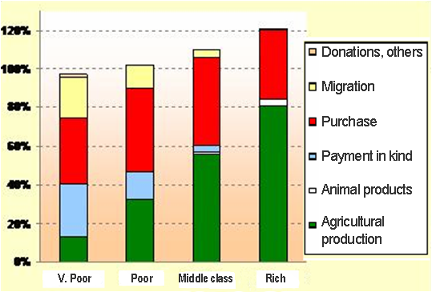
Where is food coming from? (Tessaoua, Maradi Region, Niger)
For the poorest households,
the market is the principal source of food
‘Own production’ covers barely 1 to 4 months of the dietary needs of poorest households
Source: Save the Children

Slide 9
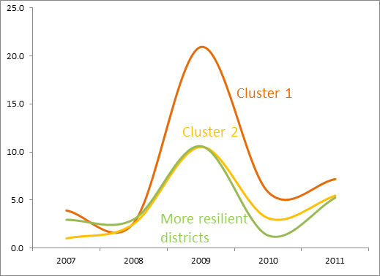
WFP Niger study – Coping Strategy Index (CSI) trends 2007-2011
Source: data from Niger Annual Household surveys

Slide 10
Version 26 Nov.
Understanding risk, analyzing vulnerability, recognizing strengths
Early Response/Early Action
Food security analysis
Grain reserves
Early blanket supplementary feeding
Pre-positioning of WASH & medical supplies
Indigenous knowledge
Awareness campaigns
EG.
Epidemics surveillance
EG.
Livestock destocking
Distrib. of agric inputs
Commercial de-stocking
Locusts surveillance
Risk assessment
Timely vaccination campaigns
Geo-political analyses
Animal feed & veterinary products
School feeding
Livelihoods assessment
Vulnerability mapping
Water management
Harvest projections
Risk Assessment technologies
Targeted inter-sectoral emergency activities
Implementing MISP for sexual & reproductive health
Seasonal analyses
Mechanisms in place to purchase local food products for food aid
Early return to school
Rehab of wells for agric & pastoralist use
EG.
EG.
Early warning systems
Reestablishing livelihoods
Disaster preparedness
National response strategies
Rehabilitation of agricultural land
School gardening
Simulation exercises
Updated 4W
Cross border coordination mechanisms
Safety nets
National coordination systems
Animal feed & Vet care
Agric. Input shops
Skill training of local NGOs
Re-launch of basic social services
Contingency planning
Livestock re-stocking
Forest Fire management training
Early release financing mechanisms
Emergency
Preparedness
Early
Recovery
Humanitarian actors and Resilience programming

Slide 11
Strategic Objectives (2014-2016)
1.
Track and analyse risk and vulnerability, integrating findings into humanitarian and development programming.
Support vulnerable populations to better cope with shocks by responding earlier to warning signals, by reducing post-crisis recovery times and by building capacity of national actors.
2.
Deliver coordinated and integrated life-saving assistance to people affected by emergencies.
3.

Slide 13
Proposed Actions
Development of common risk and vulnerability assessment methodology
Early Warning - IASC input on risk assessments in non-crisis countries
‘National resilience strategies’ models (EU/AGIR)
Resilience measurement
Equitable donor funding of all key sectors

Slide 14
Proposed Actions (cont’d)
Multi-year humanitarian financing
Inter-cluster dialogue (food security, nutrition, epidemics)
Role of regional vs. national sector/cluster leads
Divisions of labour (humanitarian vs. development) in areas of common endeavour
IASC engagement in the development programming cycle

