Slide 1

UNICEF/WFP Return on Investment Study for Emergency Preparedness
IASC Humanitarian Financing Task Team
18th of March 2015

Slide 2
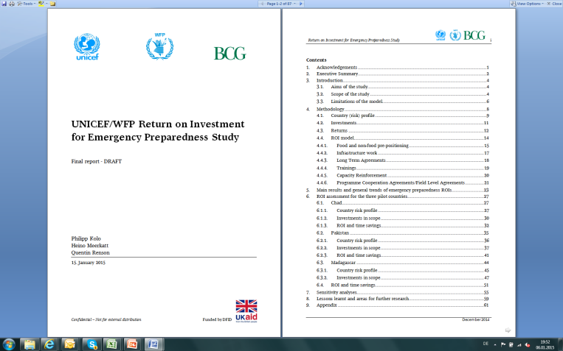
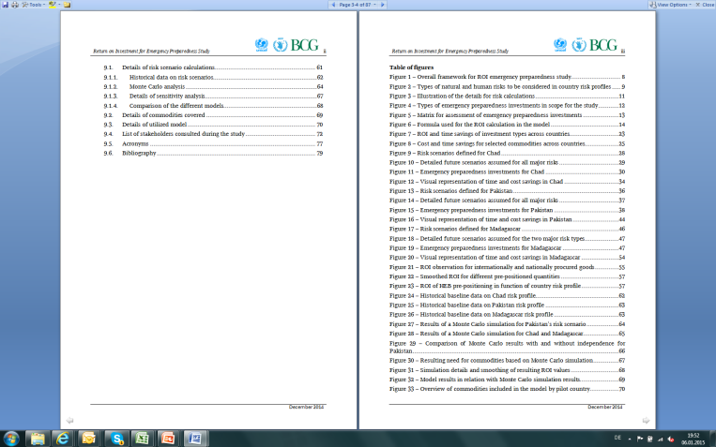
Objectives: Develop model and apply it in 3 countries
Develop a model to assess the return on investments for UNICEF and WFP preparedness activities along two dimensions: cost and time savings
Apply the model and calculate ROI for 49 emergency preparedness investments in three high-risk humanitarian pilot countries: Chad, Madagascar and Pakistan

Slide 3
Overall framework and key building blocs
Emergency
Investments
Return
Preparedness
interventions
2
Early recovery and
emergency response
3
4
ROI
Model
1
Country (risk) profile
Country
(risk) profile
1
Preparedness
interventions
2
3
4
ROI Model
Returns
  Broad range of risks analyzed
  Different scenarios defined per country
  Scenarios based on historical and predictive data
  UNICEF/WFP emergency preparedness invest-ments under the DFID grant as starting base for analysis
  Single ROI model for returns on emergency preparedness using Excel
  Model intended to be used by UNICEF/WFP in various humanitarian contexts
  Cost and time returns quantified by comparing situation with and without advance investments
  Qualitative benefits expected to complement discussion

Slide 4
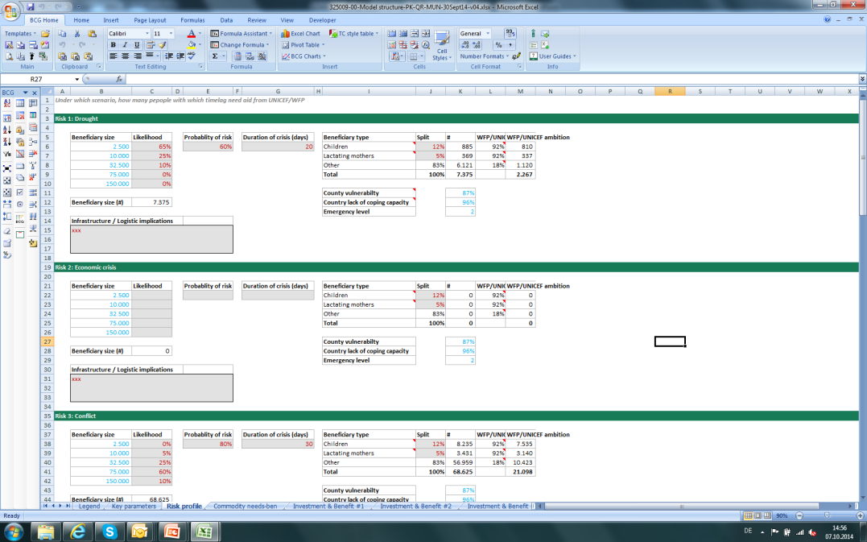









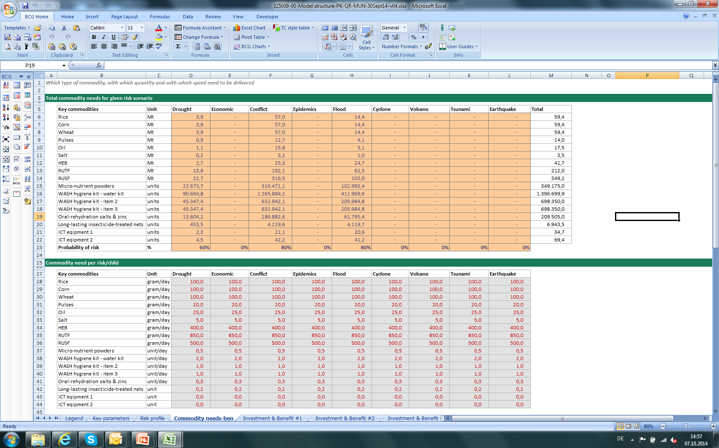

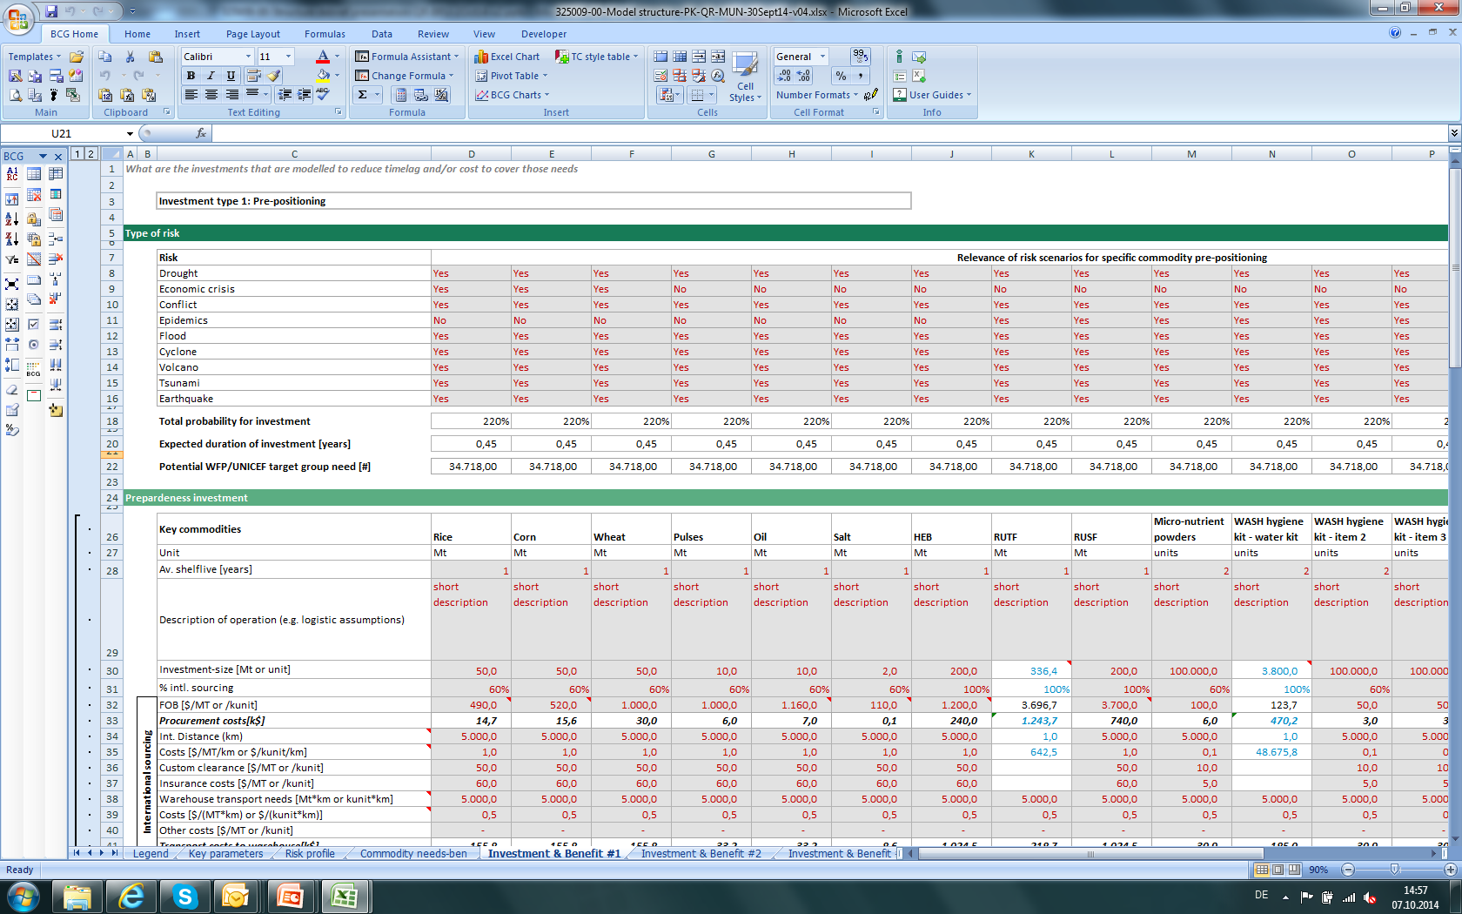

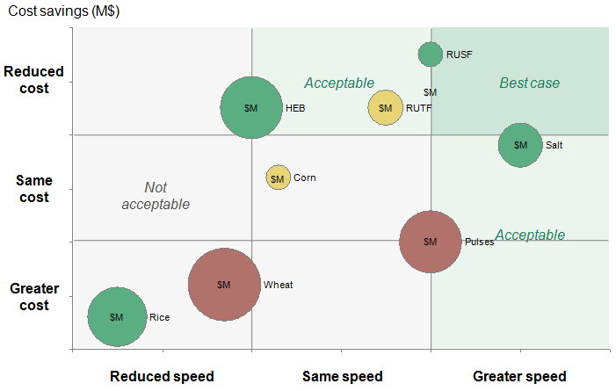
Excel model developed to support
ROI assessment
The model consolidates
various Inputs …
… to calculate the Return of
all investments
1
Risk scenario parameters
  E.g.,
  # beneficiaries
  Duration
  …
Detailed risk scenarios
Beneficiary need entered for all target groups
2
Emergency preparedness investments
  E.g.,
  Prepositioning of key commodities (M€, price, etc.)
  …
Excel supporting tool
Risk relevance of investments directly impacts return
3
Other assumptions
  E.g.,
  Transportation capacity means
  International logistic costs
  …
Cost and time reduction for all investments

Slide 5






6 types of preparedness investments in scope Exemplary investments from the different pilot countries
Logistics/ICT
Procurement
Staffing
Ext. contracting
I
Food and non-food pre-positioning
IV
Trainings
VI
PCAs/FLAs
Pre-positioning of essential food and nutritional commodities (High Energy Biscuits, Ready to Use Therapeutic Food, etc)
Emergency contingency programme cooperation agreements with partners
Emergency Preparedness and Response Planning training
Pre-positioning of WASH stocks (soap,
bleach, etc)
IT emergency management training
Standby agreement for Rapid Response
Pre-positioning of operational support equipment (ICT and Mobile Storage Units)
II
Infrastructure work
III
Long Term
Agreements
V
Capacity
reinforcement
Reinforced capacity for needs assessments
Airstrip rehabilitation
Long Term Agreements for goods, transportation and services
Optimization of (inter)national roster
Warehousing optimization

Slide 6
Quantitative ROI—time and cost savings—for 49 investments
ROI > 1 indicate financially positive investments—they save more than the investment
ROI
20
3
2
All investments
with time savings < 0 represent faster emergency response
1
0
All investments
0
10
20
30
40
50
Time differential (days)

Slide 7

Internationally procured pre-positioned goods
Quantitative ROI—time and cost savings
Example: 2 MSUs² in Madagascar
ROI
With pre-positioning
Without pre-positioning
20
K$
28.2
52.6
24.4¹
3
Procure-
ment
Trans-
port
Storage
Total
Procure-
ment
Trans-
port
Storage
Total
Delivery time:
~ 2 days
Delivery time:
~ 9 days
2
ROI: 1.6
  Time savings: ~ 7days
1
Pre-positioning
intl. goods
0
0
10
20
30
40
50
Time differential (days)
1. Lower procurement cost without pre-positioning as the purchase takes place later on when the emergency hit the country and prices are discounted to reflect present value. 2. Mobile Storage Unit

Slide 8
Infrastructure work
Quantitative ROI—time and cost savings
Example: Airstrip rehabilitation in Chad
ROI
With rehabilitation
Without rehabilitation
20
K$
Annual operating costs
2,500
2,340
2,000
1,400
1,490
1,736
1,500
1,000
3
500
0
Dash 8 full year
Maintenance cost
Total
Helicopter rainy season
Let 410 dry season
Total
2
Initial investment:
680 k$
Total cash flows: 5.2 M$ [850 k$ annual savings]
ROI:7.7
  Time savings: ⁻¹
1
Pre-positioning
intl. goods
Pre-positioning
local goods
0
Infrastructure work
0
10
20
30
40
50
Time differential (days)
1. The time savings achieved through one additional rotation per day by fixed-wing aircraft as opposed to helicopter trips is negligible compared to the multiplier effect to other humanitarian partners. Since increased access to affected populations in Tissi during the rainy season could potentially translate to faster response times for their respective emergency operations but were out of scope.

Slide 9
Summary of findings (1)
Of the US$5.6 million invested in preparedness in the three countries, US$12 million was saved - more than double the investment.
All preparedness investments saved either costs or time. 64% of them saved both.
75% of investments demonstrated significant cost-savings.
93% of investments saved time. None increased time.
Response time was accelerated by one week, on average.

Slide 10
Summary of findings (2)
Pre-positioning of internationally-sourced supplies yield ROIs of 1.6 – 2.0 and significant time savings (14-21 days average) across all pilot countries.
Large infrastructure investments yield the highest absolute money savings (up to US$ 5.2m).
The level of a country’s dependency on external goods and services, corresponds with higher ROI to ensure their availability in an emergency.
Countries with higher coping capacities have higher ROIs for human capital (e.g. training and organizational capacity).
Investments have various additional qualitative benefits for humanitarian action.

Slide 11

Thank you

