Slide 1
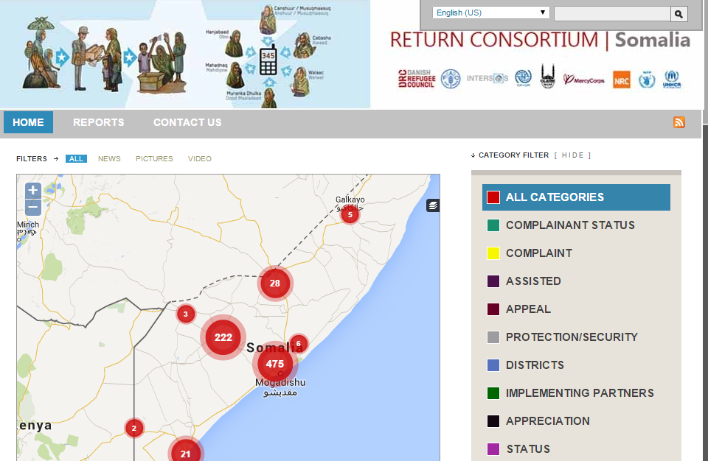
The Somalia Return Consortium : Beneficiary Feedback
IASC AAP PSEA task team meeting

Slide 2
The Somalia Return Consortium
The Somalia Return Consortium is established to respond proactively to the trends indicating an increased interest in voluntary returns as a solution to displacement in Somalia.
The Consortium members offer comprehensive and standardized support to internally displaced Somalis who wish to voluntary return home and resume lives in their area of origin.
The Consortium was established in mid-2012, and has since then been assisting people to find solutions to end what is often years of displacement.

Slide 3
The Feedback System
The Feedback System provides beneficiaries a channel to voice their concern and provide direct feedback on the support offered by members of the Somalia Return Consortium.
Calls and SMS from Somalia are received 24/7 and a response is provided within days.
All feedback is published and shared online through an innovative communications platform that aims to promote humanitarian aid accountability and transparency.
The feedback is analyzed and provides the Consortium with an evidence-base that guides needs to revise and adjust the assistance provided.
Notes:
International agencies working in Somalia manage their operations via remote management from Nairobi, Kenya, due to security constrains in operational areas not considered not safe. Therefore International staffs do not always have full and continuous access to projects’ areas. Managers, therefore, rely mainly on reports from national staff on the ground, third part monitoring and/or their contractors, mechanisms that are not always effective and efficient.
The Return consortium(RC) beneficiary feedback mechanism significantly narrows down the distance between the target beneficiaries and aid agencies for meaningful participation and dialogue.

Slide 4
The Feedback System platform
Notes:
Beneficiary sends an SMS or Voice call to 345 which is connected to all the four telecom service providers in Somalia then gets an automatic response saying “ Thank you for your feed back, we will get back to you in three days or your SMS will be shared with concerned agency for follow up.
Its then analysed, translated into English and uploaded on the dashboard.
SMSes are followed up through agency focal points and an appropriate response is given to beneficiaries.
When problem is fixed, DRC MIS Officer records it on the dashboard.
After that, an automatic response is sent to the reporting beneficiaries (e.g. “your problem has been fixed, please verify by SMS). Then recorded as processed otherwise will remain pending.

Slide 5
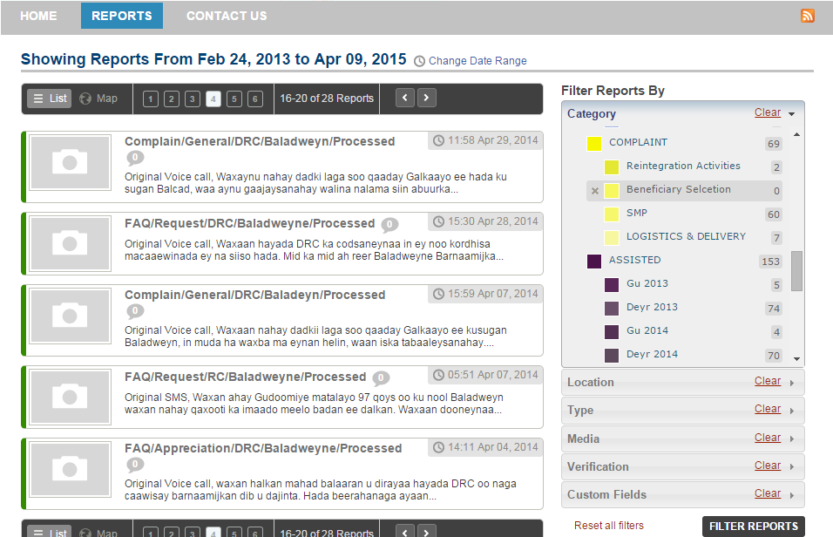
The Feedback System platform
Notes:
What are the main types of feedback received
Security of the return area
Need for extra support
Request for humanitarian assistance.
Quality and quantity of services provided.
Appreciation of support from DRC.

Slide 6
Strengths
DRC management of the Return Consortium beneficiary feedback mechanism is well resourced.
Beneficiary culture of using phone.
No cultural barriers in using the mechanism.
Network coverage in all return areas.
Operational system that can be used to capture both operational and sensitive complaints.
Funding for the services to ensure they are free to beneficiaries(fully funded by UNHCR)
Roll out of the feedback mechanism to all returnees.
Maximum utilization of other products like clickatel to enhance feedback for beneficiaries, Interactive Voice Response and sms live monitoring and sms tracker for accountability purposes.

Slide 7
Areas of Improvement
Telecom service providers charging beneficiaries for services yet the organization pays for them.
High level of illiteracy among the beneficiaries to use SMS.
Roll out of the feedback mechanism especially in insecure areas.

Slide 8
Examples of Feedbacks
I have recently left Kenya with my family to return home to Somalia. We want to resettle in Kismayo where we originally come from. But it is not easy and we face many difficulties. The water point is far from where we live and we struggle to bring water back home. Can you help us and give us a donkey cart to transport our water?
We are grateful for the training provided to us as returnees to improve our livelihoods. It is very helpful. However, we need more boats and fishing equipment so that we can catch more fish.

Slide 9
Examples of Feedbacks
3. We would like to inform you that we have crossed the border from Kenya and returned to Somalia. But we are stuck in the outskirts of the border town Dhobley for one hour without knowing what the reason for this delay is. Our children are affected by the situation and cannot cope with the heat here.
Followed up with Somalia focal point who liaised with the local authority who instructed managers of check points to allow them proceed with the journey.

