Slide 1
Understanding Vulnerabilities and Strengthening Response
Community-based Integration of Anti-trafficking and Human Rights Protections
within Post-Earthquake Recovery Efforts in Sindhupalchok District, Nepal

Slide 2
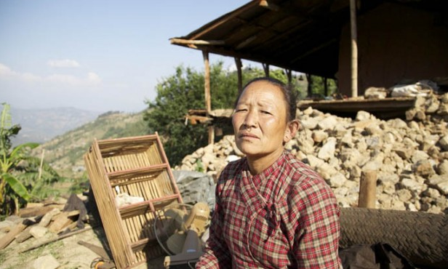
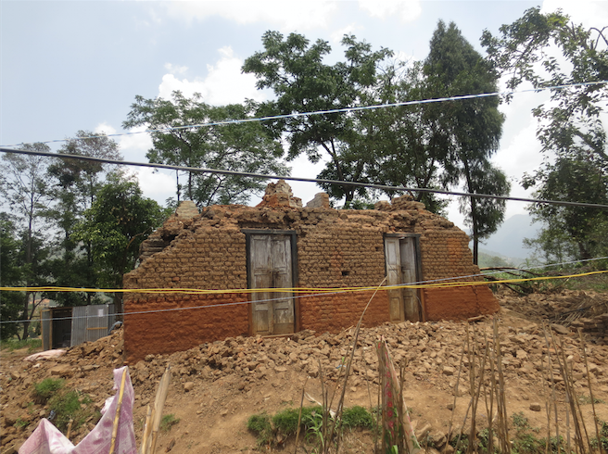
April and May 2015 earthquakes, Central Nepal

Slide 3
Government of Nepal’s Post Disaster Needs Assessment: 14 out of the country’s 75 districts were “crisis hit”.

Slide 4
High risks after the earthquake
Concerns about human trafficking.
Concerns about increased physical and sexual abuse.
Capacity of government, international and national relief agencies to offer protections seemed quite limited
In this context, the capacity of local residents to identify risks and take protective actions was vital.

Slide 5
Purpose of the project
Understand changes in human trafficking and other violence and abuse.
Strengthen community-based protection mechanisms.
Learn more about what results could be achieved through such mechanisms to prevent trafficking and violence.
Can frontline workers living in the area be consulted and trained during the aftermath, and what practical actions could they undertake as a result?
Partners: Swatantrata Abhiyan, Gramin Mahila Srijansil Parivar (GMSP), Free the Slaves Nepal

Slide 6
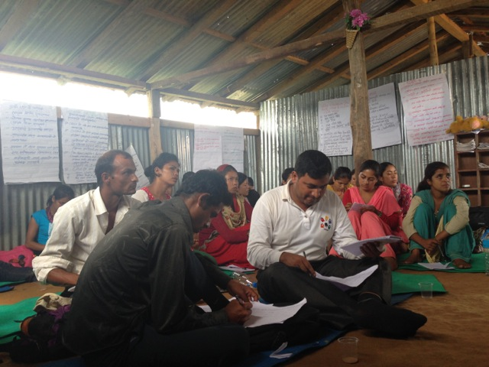
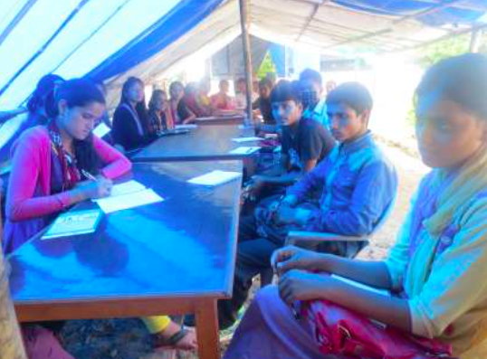
Undertaking the action research in Sindhupalchok district
Scoping interviews with 18 key informants from Sindhupalchok district;
Consultative training workshops for 81 frontline workers of community-based NGOs; and
Follow up visits with 33 participants to map out changes and learning

Slide 7
Content of consultation/training:
How to identify vulnerable individuals and human rights violations;
Information on assistance available;
How to reunite unaccompanied or separated children with caregivers;
How displaced people in tents or camps can watch out for traffickers and for violence against women and children, and can know how to respond and report on these issues;
How to boost local residents’ awareness of these risks;
How to coordinate between local groups around these issues; and
Other emerging issues from participants.
Each workshop included creation of action plans by participants.

Slide 8
Findings about increased incidents and risks:
Participants provided valuable information on the causes of increased vulnerability to human trafficking
Resulting desperation PLUS unrestricted access to the affected populations offered an opportunity for traffickers.
Violence and abuse against women and children:
increased neglect and violence by parents following the earthquake
risk of sexual harassment due to unsafe settlements and sanitation access

Slide 9
Participants identified key gaps in response:
Some examples:
Relief and protection efforts were concentrated in accessible areas.
Nepalese organizations had trouble actively participating in cluster meetings.
Human trafficking and other risk issues were not well incorporated into other relief clusters.
NGOs/INGOs often did not communicate about their community level activities.
Police posts were not properly able to handle cases of violence and abuse.

Slide 10
What could trained field staff actually do?
A lot - just a few examples
Revitalising official village child protection and anti-trafficking committees in 30 places
Creating systems in temporary camps to alert each other to strangers or new (questionable) relief agencies
Rapid response when individuals were leaving the village in risky circumstances – including rescuing some while in transit with traffickers.
Set up monitoring and lighting systems at vulnerable places around the camps. Regulated use of alcohol in some locations.

Slide 11
Good practices and recommendations:
Areas where there had been anti-trafficking/child protection activities before the disaster were more resilient to trafficking, violence and other risks.
Community-based facilitation of access to protection schemes enhanced actual access.
Quickly strengthening local mechanisms has positive outcomes.
Vital to integrate protection activities across all of the cluster activities to detect problems and intervene. All cluster interventions should use a protection checklist.
Support participation of such workers in cluster meetings.

Slide 12
Contact:
Ginny Baumann, Freedom Fund: gbaumann@freedomfund.org
www.freedomfund.org
Action Research Report:
Understanding Vulnerabilities and Strengthening Response
Download at:
http://freedomfund.org/wp-content/uploads/Understanding-Vulnerabilities-and-Strengthening-Response-March-7-2016.pdf

Slide 13
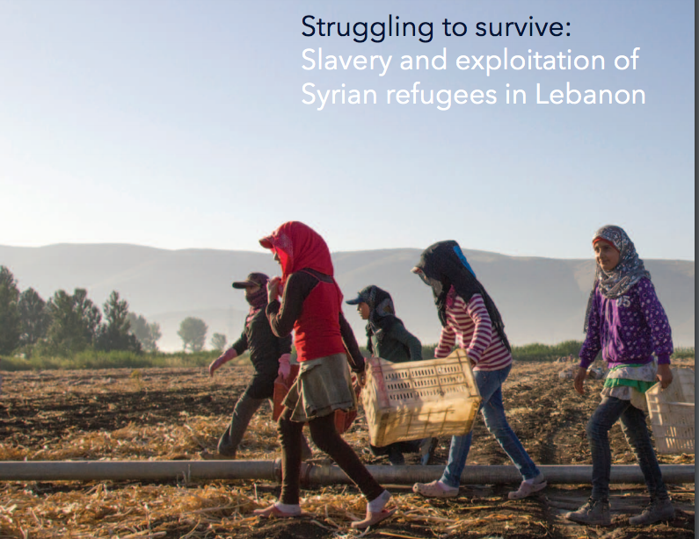

Slide 14
Struggling to Survive
Dr. Katharine Jones, Senior Research Fellow, Centre for Trust, Peace and Social Relations, Coventry University: Katharine.Jones@Coventry.ac.uk
Leena Ksaifi, Independent Consultant and Director of the George Ksaifi Organisation: l.ksaifi@tgko.org
Freedom Fund contact: aguichon@freedomfund.org
Download at:
http://freedomfund.org/wp-content/uploads/Lebanon-Report-FINAL-8April16.pdf

