Slide 1
IASC REAP meeting | 13 October 2016
Update on workstream
Emergency Response Preparedness approach

Slide 2
Overview
Progress and next steps in rolling out the ERP approach
IASC REAP sub-group on ERP approach
Status of roll-out and the online ERP platform
Trainings and country support missions
ERP guidance and communication
Next steps

Slide 3
1) IASC REAP sub-group on ERP approach
The sub-group on the ERP approach was established in July 2016 to promote implementation of inter-agency preparedness in the field, in particular in countries identified as at high risk of crises requiring an international humanitarian response. The sub-group is expected to contribute to this goal by:
ensuring strong inter-agency collaboration in the roll-out and adaptation of the ERP approach;
establishing clear links between risk analysis and preparedness action;
providing guidance and tools to and ensuring operationalization by Country Teams implementing the ERP approach; and
improving the flow of information on the ERP and preparedness requirements within and between the participating agencies.
The sub-group is expected to work closely with the Early Warning Early Action group and other relevant IASC bodies.
Notes:
One of the tasks of the IASC Reference Group on Risk, Early Warning and Preparedness (REAP) is to work to heighten inter-agency preparedness to respond to breaking humanitarian crises. The agreed tool for ensuring such readiness is the Emergency Response Preparedness (ERP) approach, which was endorsed by the Emergency Director’s Group in July 2015.

Slide 4
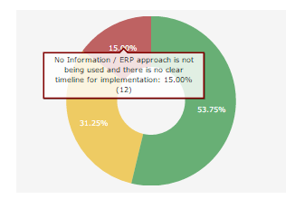
2) Status of ERP roll-out
ERP is being implemented i.e. risk analysis completed and MPAs/APAs prioritized and in progress in 43 countries,
ERP has not yet been implemented, but work is underway to start implementation in the next 3 months in 25 more countries,
No information / ERP approach is not being used and there is no clear timeline for implementation in 12 countries
80 countries are being monitored. These include countries, which have been identified as priorities based on risk analysis and countries where the ERP implementation has already begun.

Slide 5
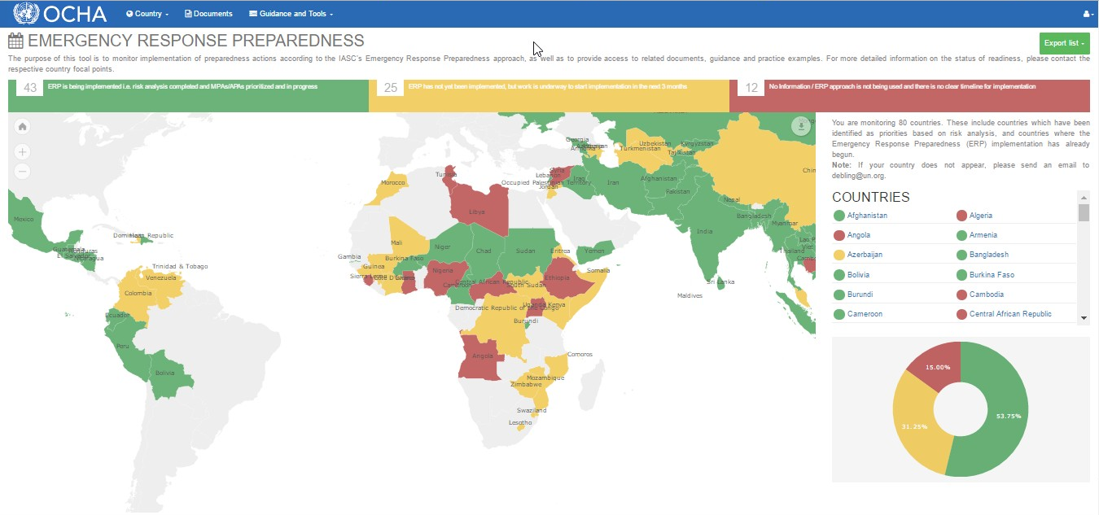
The online ERP Tool
Helping country offices track implementation and access good practice

Slide 6
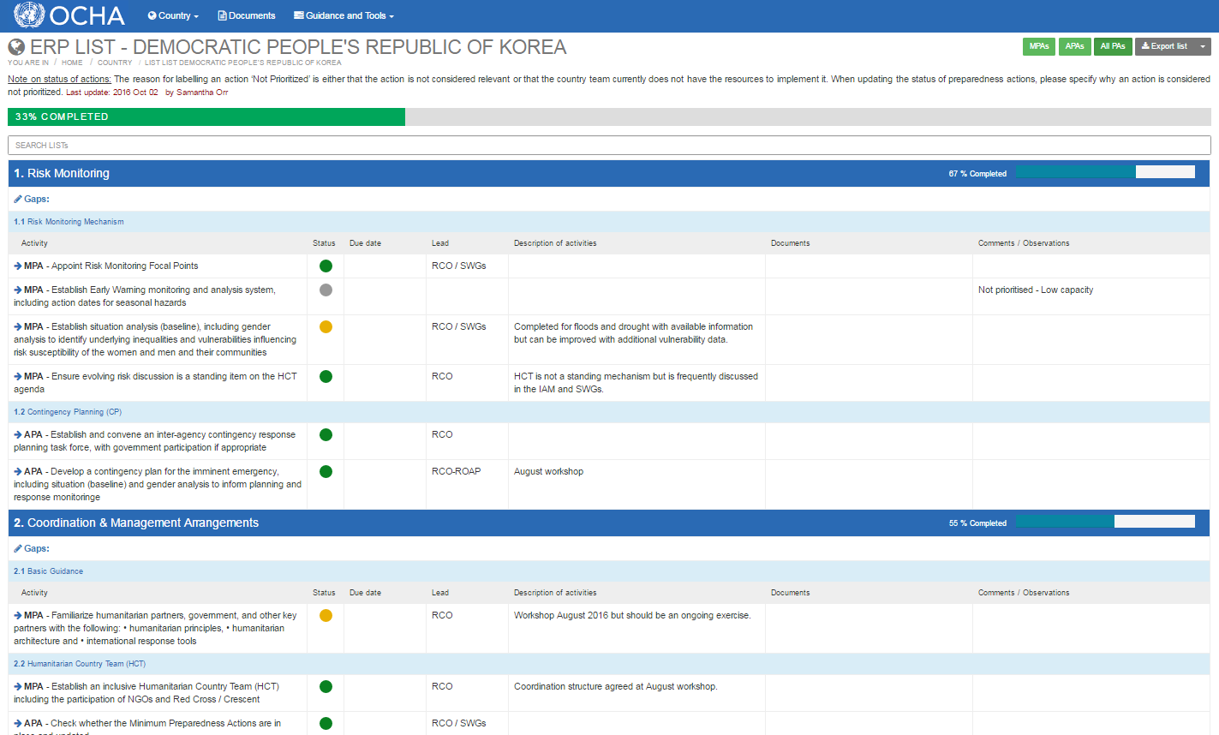
Preparedness Actions

Slide 7
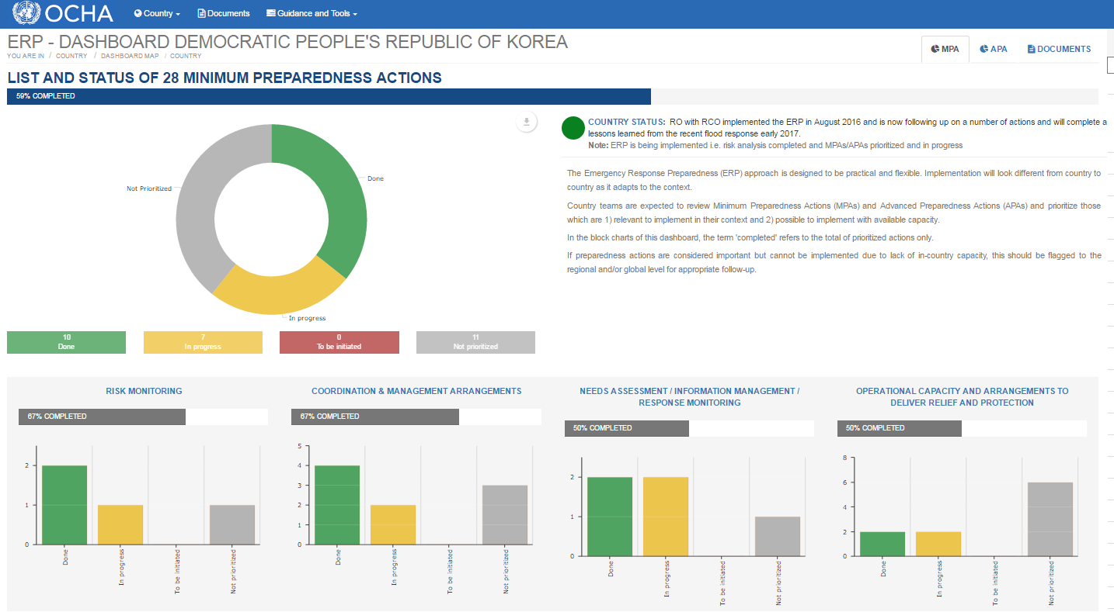
Dashboard

Slide 8
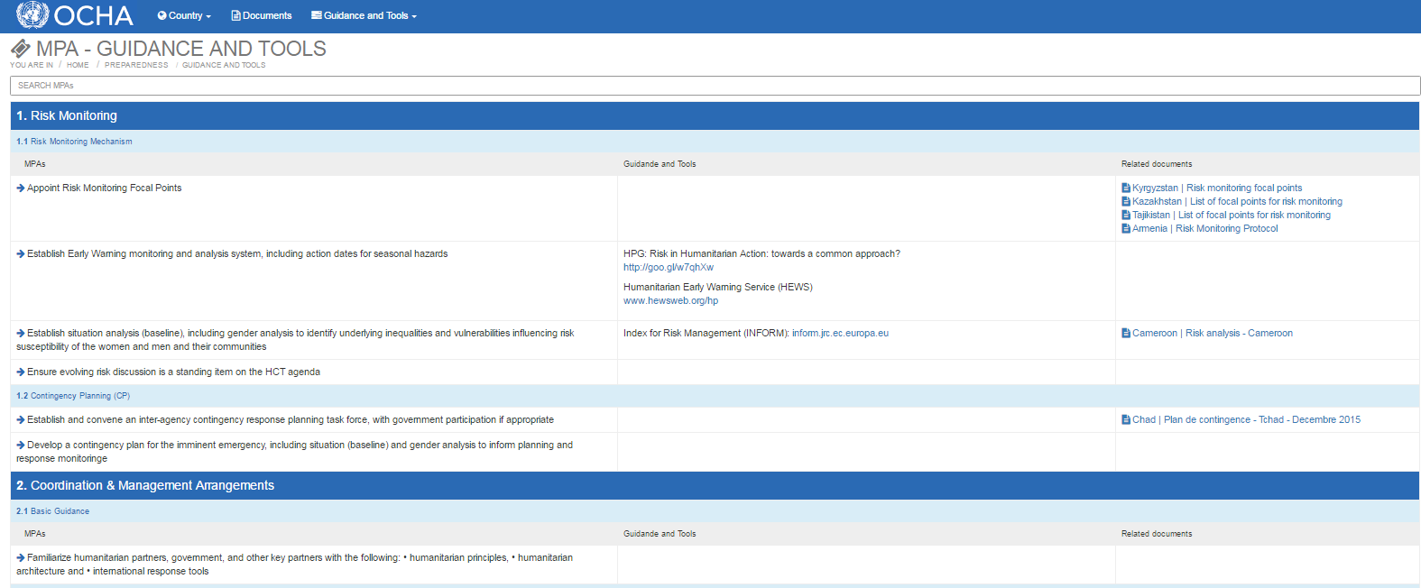
Documents
Related Documents on country dashboard
Documents Library – filter
View per MPA under Guidance and Tools

Slide 9
ERP Tool – Next Steps
Currently first field testing / data entry - October
Launch of the ERP Tool – November
Access for IASC partners
Discuss if desire to adopt as IASC tool

Slide 10
3) ERP Trainings and country support missions
More than 270 people trained on the ERP approach in seven locations
RCs
Completed
Planned
NGO/UN/ Gov.
OCHA
Bangkok
Panama
Tbilisi
Istanbul
Cairo
Amman
Dakar
Geneva
Nairobi
New York
274 people trained
CO support missions
Lesotho
Swaziland
Cameroon
Niger
Philippines
Iraq
Burkina Faso
Sudan

Slide 11
Upcoming ERP support missions and trainings
Country | Activity and dates
Kenya | Regional Training of Facilitators, 31 October – 1 November
Morocco | ERP support mission, 20-25 November
Chad | ERP support mission, 27 November – 2 December

Slide 12
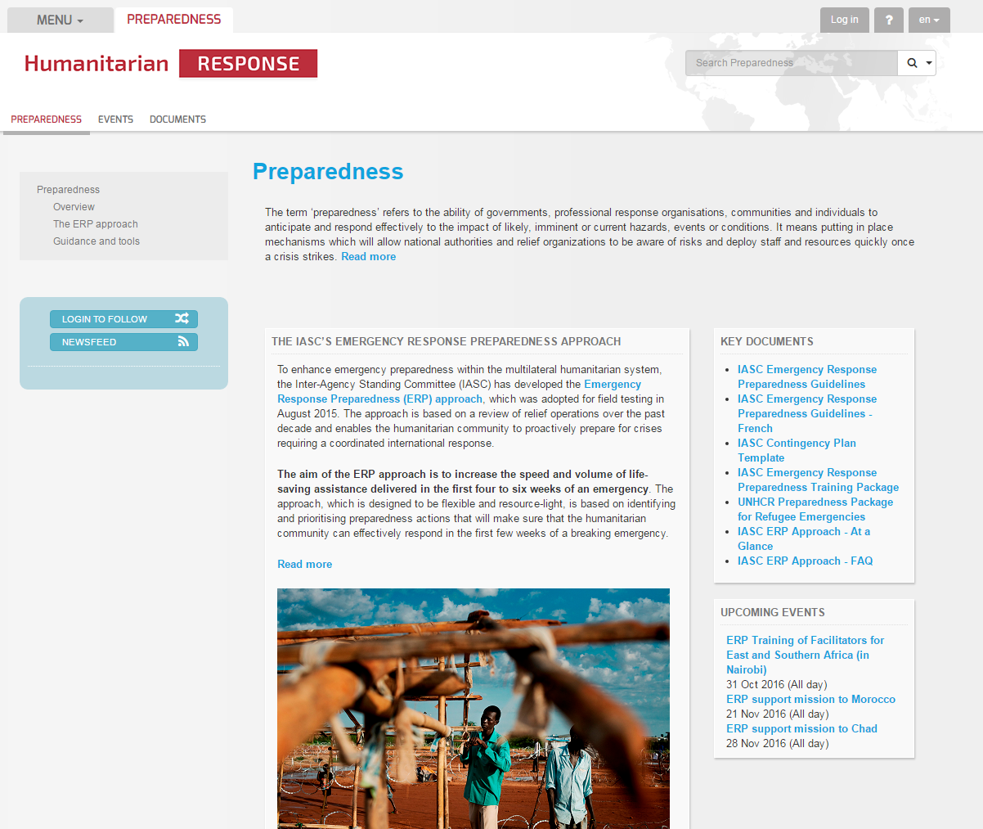
4) ERP guidance and communication
Revamped presence on Humanitarianresponse.info
ERP guidance has been translated into French and Spanish
Short communication material (summary and FAQs) established

Slide 13
5) Next steps
Support to country implementation
ERP review in 2017
ERP Tool

