Slide 1
Advancing the Outcomes of the
World Humanitarian Summit and
the Agenda for Humanity

Slide 2

Agenda for Humanity - The Change Framework
5 Core Responsibilities: 24 Strategic Shifts

Slide 3

Notes:
Homepage

Slide 4
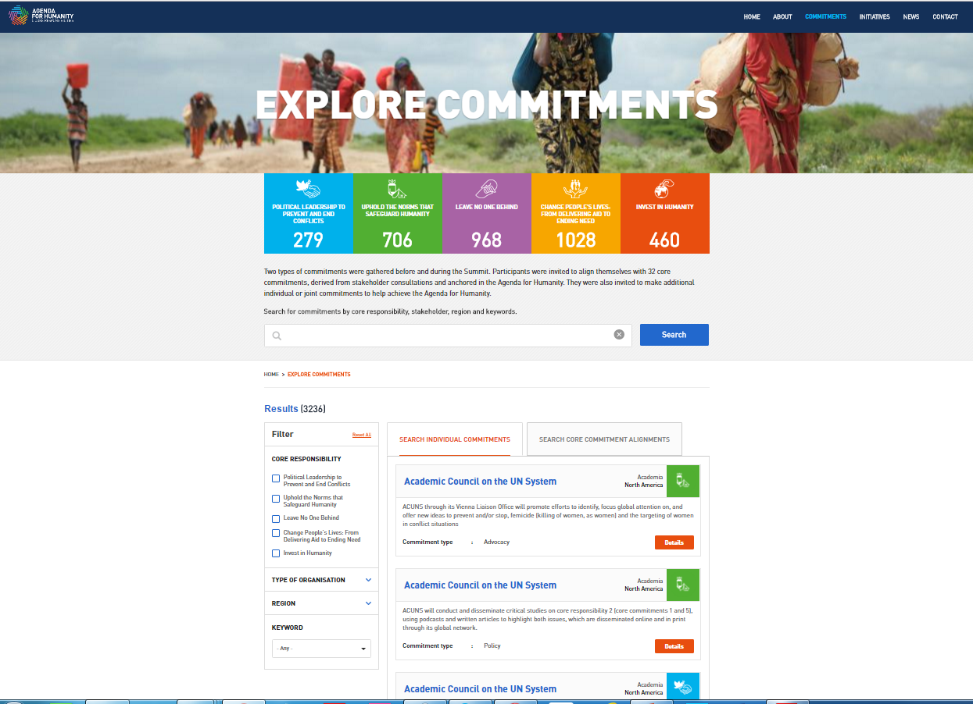
Notes:
Commitments Search Page – Individual commitments (highlighted in yellow)

Slide 5

Notes:
Stakeholder Page

Slide 6
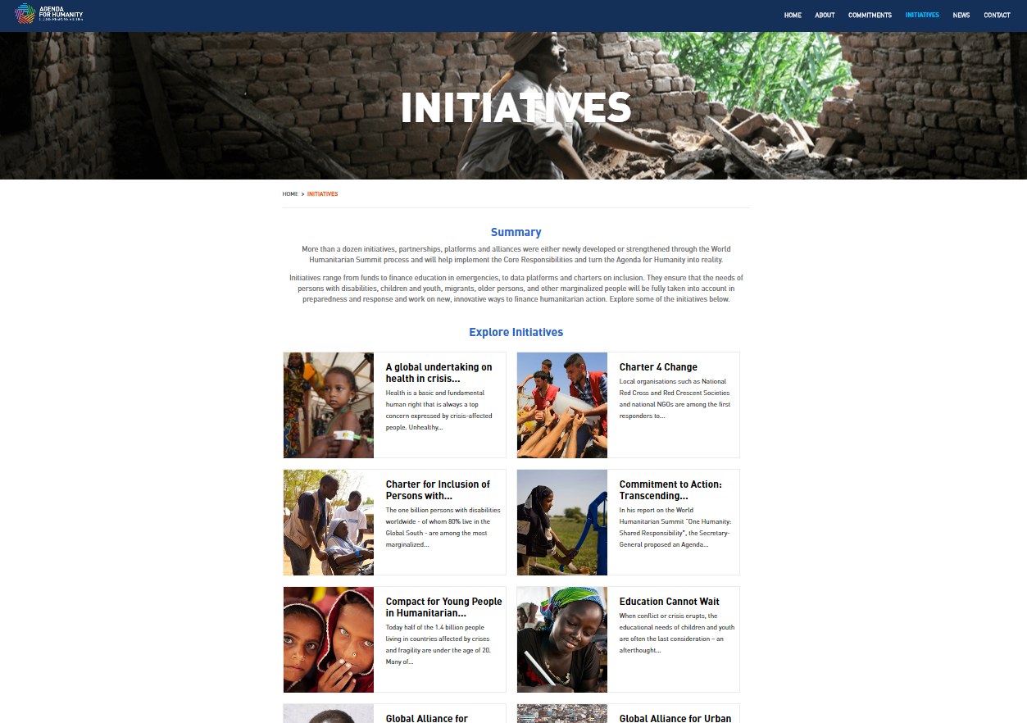
Notes:
Initiatives page

Slide 7

Notes:
Individual Initiative Page

Slide 8

Notes:
News & Updates page

