Slide 1
IASC HDN TT
Criteria of the Humanitarian Development Nexus

Slide 2
5 Criteria of HDN
Collective Outcomes
Joint Planning and Analysis
Progressively Ending Needs
Government/Local Leadership
Protracted Response

Slide 3
Collective Outcomes
Achieving effective outcomes for people, particularly in fragile and crisis-affected environments, requires a different kind of collaboration among Governments, international humanitarian and development actors and other actors: one that is based on complementarity, greater levels of interoperability and achieving sustainable, collective outcomes rather than the coordination of individual projects and activities.

Slide 4
Joint Planning and Analysis
All relevant actors from national and local authorities and the humanitarian, development, environmental and peace and security communities need to come together to achieve a common understanding of risks, needs, gaps and existing capacities.

Slide 5
Progressively Ending Needs
Success should be defined by the achievement of measurable reductions in people’s risk and vulnerability and their ability to become more self-reliant rather than simply attain basic needs for years on end.

Slide 6
Government/Local Leadership
“As local as possible, as international as necessary”. The design of coordination arrangements must begin with the national authority to augment and not replace existing capacity. Where capacity does not exist, or host government is unwilling attention should be given to capacity development with the view of handing over and exiting when possible.

Slide 7
Protracted Response
We are increasingly facing a changing operational landscape, due to increase in unrelenting complex crises. These are creating new operational environments that a characterised by unprecedented levels of affected populations trapped or displaced over a long period of time and require long term solutions requiring stronger collaboration between development, humanitarian, peace and security actors is most need.

Slide 8
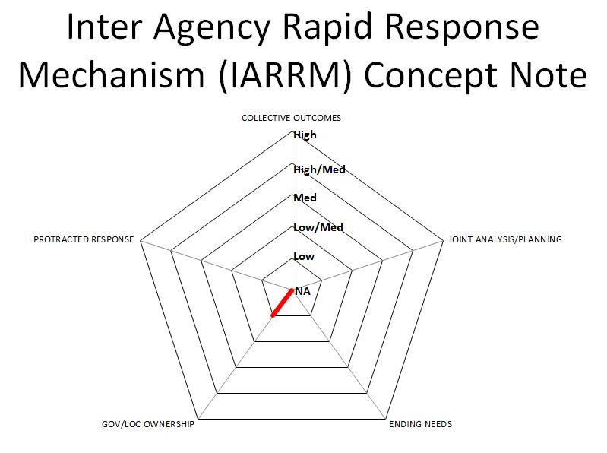
Method
Use five dimensions to assess the existing response protocols on a 5 point scale (+ N/A) with the aim of preliminarily ascertaining to what degree these protocols are adapted to protracted situations that require strong humanitarian, development, peace and security integration.

Slide 9
Current Inter-Agency Emergency Response Protocols
Empowered Leadership;
System Wide L3 Activation;
What Empowered Leadership Looks like In Practice;
Reference Module for Cluster Coordination;
Guidance on the Humanitarian Programme Cycle;
Concept note on the Interagency Rapid Response Mechanism (IARRM);
The Common Framework for Capacity Development +ERP
Operational framework for AAP;
MIRA Guidance

Slide 10
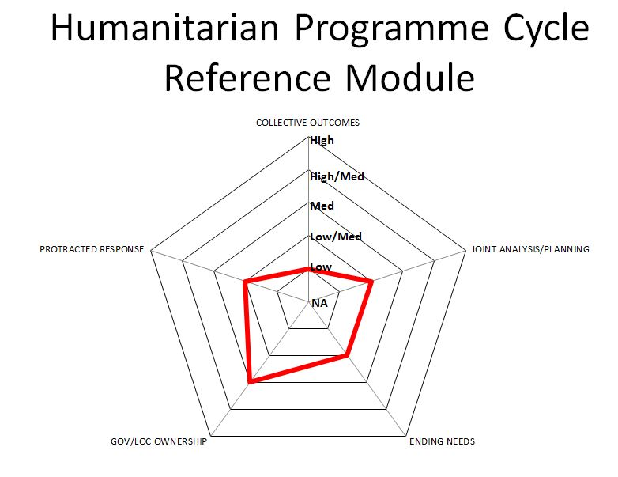
General Trends/Comments

Slide 11
Empowered Leadership Protocols
High
High/Med
Med
Low/Med
Low
NA

Slide 12
System Wide L3 Activation
High
High/Med
Med
Low/Med
Low
NA

Slide 13
Reference Module for Cluster Coordination
High
High/Med
Med
Low/Med
Low
NA

Slide 14
Humanitarian Programme Cycle Reference Module
High
High/Med
Med
Low/Med
Low
NA

Slide 15
Inter Agency Rapid Response Mechanism (IARRM) Concept Note
High
High/Med
Med
Low/Med
Low
NA

