Slide 1
Project overview November 2019

Slide 2
Advancing Common Business Operations
TARGETS
ENABLERS
1
Business
Operations
Strategy
2
Common
Back Offices
3
Global
Shared Service
Centers
4
Common
Premises
5
Mutual
Recognition
6
Client
Satisfaction
Principles
7
Costing
& Pricing
Principles

Slide 3
1. Business Operations Strategy (BOS) Adopt improved Business Operations Strategy by all UN country teams by 2021
Current progress:
BOS 2.0 guidance launched in October.
BOS online tool user acceptance test conducted.
Next steps for the rollout plan defined, including country prioritization, capacity development and support structure.
What’s next?
Finalize online platform.
Global rollout activities led by Development Coordination Office (DCO):
Training of Trainers in region workshops to create core capacity with BOS experts, starting in Nov 2019;
Practitioner training for general group of staff in 2020;
Webinars and video tutorials.
>

Slide 4
4. Common Premises Increase the proportion of UN common premises to 50 per cent by 2021
Current progress:
Requires a culture shift to co-locating as the new norm, and a whole-country approach to review both capital and subnational offices.
In March 2019, an Investment Request was presented. As no resources were forthcoming, a scaled down “consolidating planning” pilot was taken in 6 countries¹ to test tools/approach.
3 pilots completed: results suggest that the consolidation planning will require external support to the UNCTs/OMTs, and that a self-review without central support may not be achievable.
What’s next?
Propose revised resource requirement.
Create new end-to-end consolidation planning guidelines / tools by Q1 2020.
Complete three more pilots.
Support DCO/TTCP+FS to develop a UN-wide premise database.
>
1. Kosovo1, Bolivia, Burundi, Colombia, Pakistan and Sri Lanka. References to Kosovo on this website shall be understood to be in the context of Security Council Resolution 1244 (1999).

Slide 5
Three “Enablers”: Mutual Recognition – Client Satisfaction – Costing & Pricing
5. Mutual Recognition Statement
Operate with the mutual recognition of best practices regarding policies and procedures
16 entities signed to date, most recently, FAO and UNRWA joining the UN Secretariat, ILO, IOM, ITU, UN Women, UNAIDS, UNDP, UNESCO, UNFPA, UNHCR, UNICEF, UNOPS, WFP, and WHO
BIG project team is facilitating entity-level and inter-agency level discussion on operationalization.
6. Client Satisfaction Principles
Measure client satisfaction with regard to all back-office services
Principles reviewed and finalized.
Shared with member entities for signature in September and first signed by UNHCR & WFP.
Process facilitated by DCO.
7. Costing and Pricing Principles
Agree on pricing principles to ensure fairness and transparency in service provision

Slide 6
Advancing Common Business Operations
TARGETS
ENABLERS
1
Business
Operations
Strategy
2
Common
Back Offices
3
Global
Shared Service
Centers
4
Common
Premises
5
Mutual
Recognition
6
Client
Satisfaction
Principles
7
Costing
& Pricing
Principles

Slide 7
Back-office activity can be optimized through global and local initiatives
Automation Review – Digital Solutions Centre
Global Business Case Review
Entity’s own centralization activities
Taxonomy review
Location independent activities
Will it be centralized?
YES
Move to global solution
Marketplace
Bilateral initiatives
Consolidation
Multi-entity initiatives
Business processes
NO
Local Business Case Review
Entity’s own processes improvements
Location dependent
activities
Keep at CO Level
Business Operations Strategy (BOS) - Cooperate
Common Back Office (CBO) - Consolidate & cooperate
Marketplace
Bilateral initiatives

Slide 8
In-country consultations held to inform the overall design
Consultation progress:
Purpose: Create fact-base and gather qualitative feedback on which service elements could be consolidated in a common back office.
Six countries participated: Albania, Botswana, Jordan, Laos, Senegal and Vietnam;
6 back-office service areas in scope: Administration, Finance, HR, Procurement, Logistics, and ICT;
Individual country report and a synthesis report were issued, drawing on the conclusions to form recommendations for the CBO proposal.
Consultation conclusions:
Highest priority focus should be on centralisation – can be done either:
Internally, or
Working bilaterally with service provider through Marketplace
Second priority is on other global initiatives that can be cross-entity:
Within BIG the focus is Marketplace and Fleet Services concept
Associated but outside BIG there are Humanitarian Booking Hub and Digital Solution Centre
Third priority is the Common Back Office in country, with lower relative business case saving opportunity but vital for efficiency and quality improvements
>

Slide 9
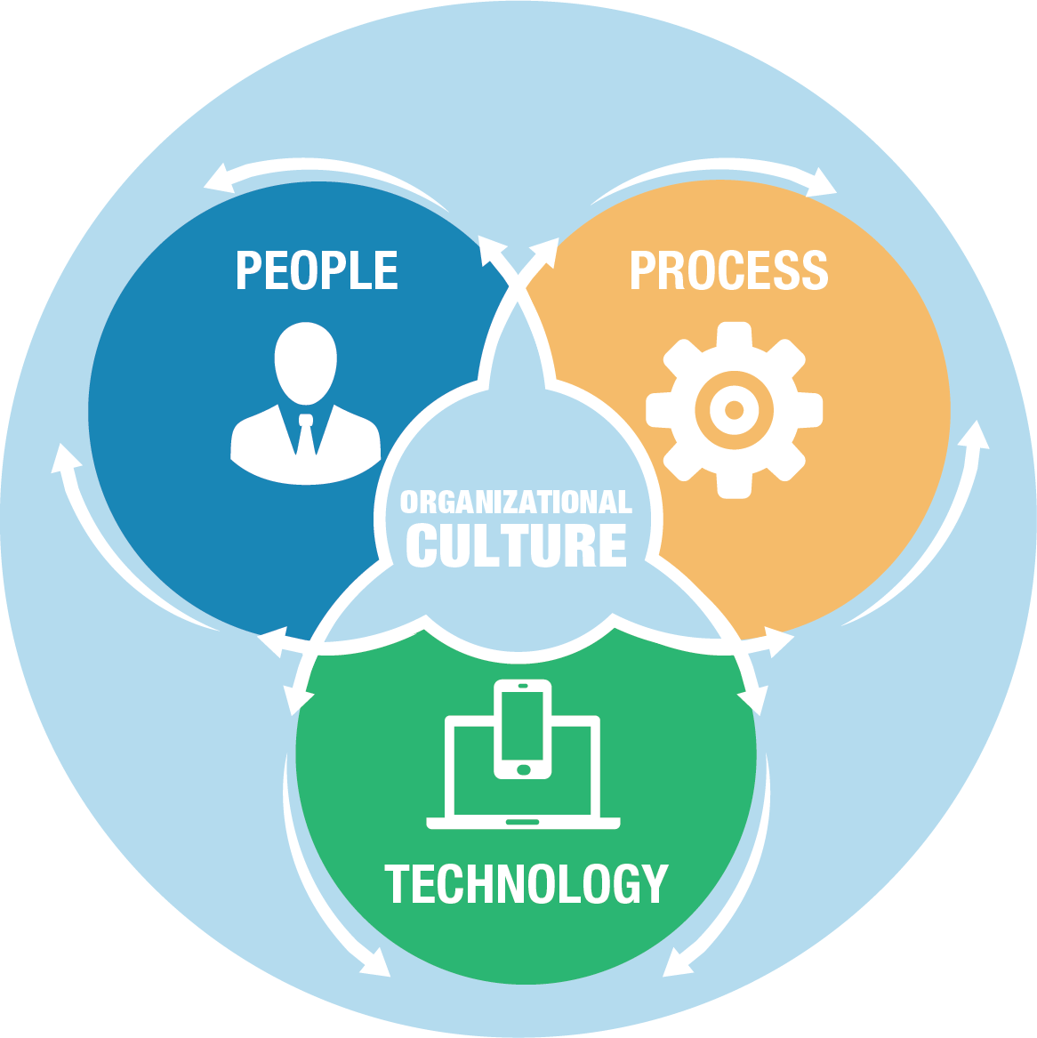
2. Common Back Offices (CBO) Establish common back offices for all UN country teams by 2022
Proposal is to scale up BOS as a foundation for CBO
BOS is a key deliverable of BIG and a foundation for CBO
BOS successfully promotes cooperative behavior
BOS is established, demanded by the field, and has promoted significant collaboration and realized tangible cost avoidance
BOS online platform can be scaled to handle heavier duty Common Back Office functions
BOS will be rolled out to all 132 UN offices globally starting in Q4, 2019
What’s next?
Develop detailed approach, including ROI / Cost-benefit analysis and a prioritized activity list;
Develop standard SLA
Explore CBO portal design

Slide 10
BOS to CBO: CBO as a gradual evolution of maturity, not as an organizational model
CBO
(2020+)
BOS +
(Q4-2019)
BOS original
(Current)
Approach | Cooperation | Cooperation & M&E elements | Consolidation & Cooperation
Functional areas | Ad-hoc selection of activities, followed by CBA | Ad-hoc selection of activities and ROI recommendations, followed by CBA | More directed focus on potential high ROI areas; followed by CBA
Enabler | BOS guidance and templates | Streamlined guidelines & digital processes Mutual recognition SG mandated target – All UNCTs | Mutual recognition Costing & Pricing principles Client satisfaction principles
Operating framework | N/A | N/A | Service Level Agreement (SLA)
Technology | Paper-based / Excel | Online BOS platform | Online BOS platform CBO portal
Governance | UNCT/OMT + Entity-led | UNCT/OMT + Entity-led | Clear governance structure
1
2
3
4
5
6

Slide 11
3. Global Shared Service Centre (GSSC)
Explore consolidation of location-independent business operations into a network of shared service centres
Current progress:
‘UN Services Marketplace’: network of shared service centres could be based on a ‘marketplace’ concept to support the exchange of services.
Marketplace Survey launched in July 2019 through HLCM: to collect information on services activities each agency is providing or would be prepared to offer to other UN entities, and those service activities that it would potentially like to receive.
Survey results received from 21 entities, with summary report and individual entity reports published in Oct 2019.
What’s next?
Marketplace Survey Round Two: Follow-up request will be issued in Q4 2019. The new survey will seek clarification on the scope and scale of services offered, as well as request inputs from the entities which did not respond to the Round One survey.

Slide 12
Marketplace survey: Response and Results
Overview of respondents
Responses received from 21 entities to date:
FAO, ILO, IOM, UNAIDS, UNDP, UNFPA, UNHCR, UNICEF, UNIDO, UNODC, UNOPS, UNRWA, UN Women, WFP, WHO, WIPO
Five UN regional commissions: ECA, ECE, ECLAC, ESCAP, ESCWA
Awaiting response from 15 HLCM member entities
Additional observations:
IOM – no activities requested or offered at this time
ECE – no activities offered, because fully served by UNOG
Summary of results
Results are very positive: most entities willing to embark in the marketplace whether to offer service, receive, or both
There are no services requested which are not offered by at least one entity
Aggregate number of activities offered now is 1,109, with a further 120 proposed for the future
Aggregate number of activities requested is 1,041

Slide 13
New: Fleet Services workstream
Priority areas
Secondary areas
1. Right Sizing
Centralized vehicle management and car pooling
Potential to reduce fleet size by ~20%
Potential one-time acquisition cost avoidance of $140 - $200 M
3. Right Profiling
Avoid over specified vehicles¹
Acquisition of vehicles with lower specifications will reduce costs by $6-7 M recurrently
5. Disposal
strategy
Set up a global disposal scheme
Entities with a disposal strategy may realize $2000 - $6,000/ vehicle more than those without.
2. Cost management
Deploy IT tool to improve fleet cost management
Potential to reduce operating costs by $5-13 M annually
4. Acquisition strategy
Centralize procurement for economy of scale
Potential to realize recurrent savings of +/-$4 million
Other opportunities
Insurance
Lifecycle Management
Armored Vehicle
Generators
Tracking systems (fuel, emissions, maintenance, repair, road safety, security)
1. 10% target considered for all vehicle categories except 4X4 heavy duty “luxury” vehicles; All 4X4 heavy duty “luxury” vehicles should be converted to standard 4X4 heavy duty vehicles
Source: UN Fleet Services stream data template received from UN entities

Slide 14
Fleet services:
Country-level desired end-state
Challenges
Highly fragmented fleet
Inappropriate vehicles for the need
Lack of comms and IT systems
Informal/ad hoc management of fleet
Inconsistent maintenance standards
Poor cost control
Future state
Joint light vehicle fleet as a common pool and service:
Centrally managed at the country level
Tasked centrally via a shared platform
Common maintenance and driver pool
Standardisation of requirements and policies:
Vehicles and ancillaries
Communications tools and IT for vehicle management, tracking, operational tasking
Common mobility policies and standards
Improved cost management:
Common costing model
Fully self-financed
Professionalisation:
Customer Service and Technical needs
Increased use of commercial solutions where appropriate

Slide 15
Fleet services:
Global-level desired end-state
Challenges
Highly duplicative:
Not leveraging economy of scale
Poor operational cost control
Lack of professionalism in organizational structure
Fragmented approach to IT and communications system
Future state - A Global Shared Service Centre:
Governance:
Governance structure in place, with close relationship to both HQ and country-level for dynamic responses
Common set of policies and SOPS in place, including requirements planning (right sizing/right profile)
Single Supply Chain:
Shared procurement and contract management;
Shared light vehicle supply chain, e.g., shipping, insurance, stocks, spares, ancillary/comms, maintenance, disposal
Financing:
Fully self-funded, self sustaining business model
Dedicated resources for operations
Shared units:
Training and Country Office Support Unit
Common Data Systems and Management Unit
Road Safety and Security Unit

Slide 16
Project team 2020 workplan
Completed / completion in the very near term
Q4 ‘19
Q1 ‘20
Q2 ‘20
Q3 ‘20
Q4 ‘20
BOS
Complete platform
Launch activities and trainings led by DCO
Common Premises
Continue pilots and testing
Finalize consolidation planning tools and guidelines
Launch led by DCO
Support database development as required, led by DCO/TTCO
CBO
GSSC
Agree on CBO model
Develop & conduct pilots, SLAs and portal
Share Marketplace 1st summary report
Develop CBO tools and guidelines
Launch led by DCO
Develop Marketplace 2nd survey
Conduct Marketplace 2nd survey
Set up governance and on-going mechanism
Enablers
Operationalize through CBO and GSSC designs &
Support entity to operationalize through facilitated discussions
New: Fleet Services
Develop Gov, Finance, IT proposal
Agree on model and pilot proposals
Develop & conduct pilots
Develop final proposal

Slide 17
Repositioning the United Nations development system also reinforces the impact of concurrent reforms of internal management and the peace and security architecture.
United Nations Secretary-General

