Slide 1
Stepping up efforts around localization in light of COVID-19
Presentation to OPAG by Result Group 1’s Localization Sub-Group
Co-chairs: IFRC and UNICEF
Members: CRS, Global CCCM Cluster, Global Protection Cluster, ICVA, IDEAS, NEAR Network, Save the Children, UNFPA, UN-HABITAT, UNHCR

Slide 2
Overview
Concept of localization
Some key points/consequences of the interim guidance
Synergies with existing IASC activities and Grand Bargain
Considerations for the OPAG

Slide 3
Main components of localization
Localization is about investment in the leadership, delivery and capacity of local responders. It is about moving beyond sub-contracting and replacement toward an overall response that is “as local as possible, as international as necessary.”
Operational issues –funding, partnership, coordination & leadership, capacity sharing, and risk sharing.
Long term goals – strengthening domestic systems (including both governmental and non-governmental actors) to be self-sufficient in the provision of basic services (e.g., health, WASH, education, protection, livelihood …), linking humanitarian and development needs.

Slide 4
INTERNATIONAL ACTORS
NATIONAL and SUB-NATIONAL ACTORS
Service delivery to Affected populations
Affected States/Government
Sub-national affected States/Government
Multilateral Institutions
Donors
National CSOs
Sub-national CSOs
INGOs
National Private sector
Sub-national Private sector
ICRC/IFRC
National RC/RC Societies
NS local branches
Goal for localization of humanitarian action

Slide 5
Key messages for localization in COVID-19 response
Safety and well-being of personnel of local partners
Equality, mutual respect, mutual accountability
Humanitarian principles
Enhancing leadership and coordination of local actors
Funding availability and risk sharing for local actors
Promoting visibility for local actors
Building back better after COVID-19 in preparation for the next pandemic

Slide 6
Addressing health risk associated with COVID-19 and duty of care for local actors
Identify, mitigate, manage, and communicate risks to which local actors are likely to be exposed.
Partnership agreements should, include dedicated actions for security risk management and health care support
Dilemma – How to avoid shifting our safety risks to local partners, bearing in mind that their access is a key comparative advantage? How much responsibility can an international partner realistically take on?

Slide 7
Capacity sharing between international and local actors
Re-orienting international surge capacity to complement regional and in-country surge capacity.
Implementation of capacity sharing models of secondment and mentoring for local actors by international actors and vice versa.
National level recruitment taking note of the needs of local actors and not incapacitating the local actors by taking away their personnel.

Slide 8
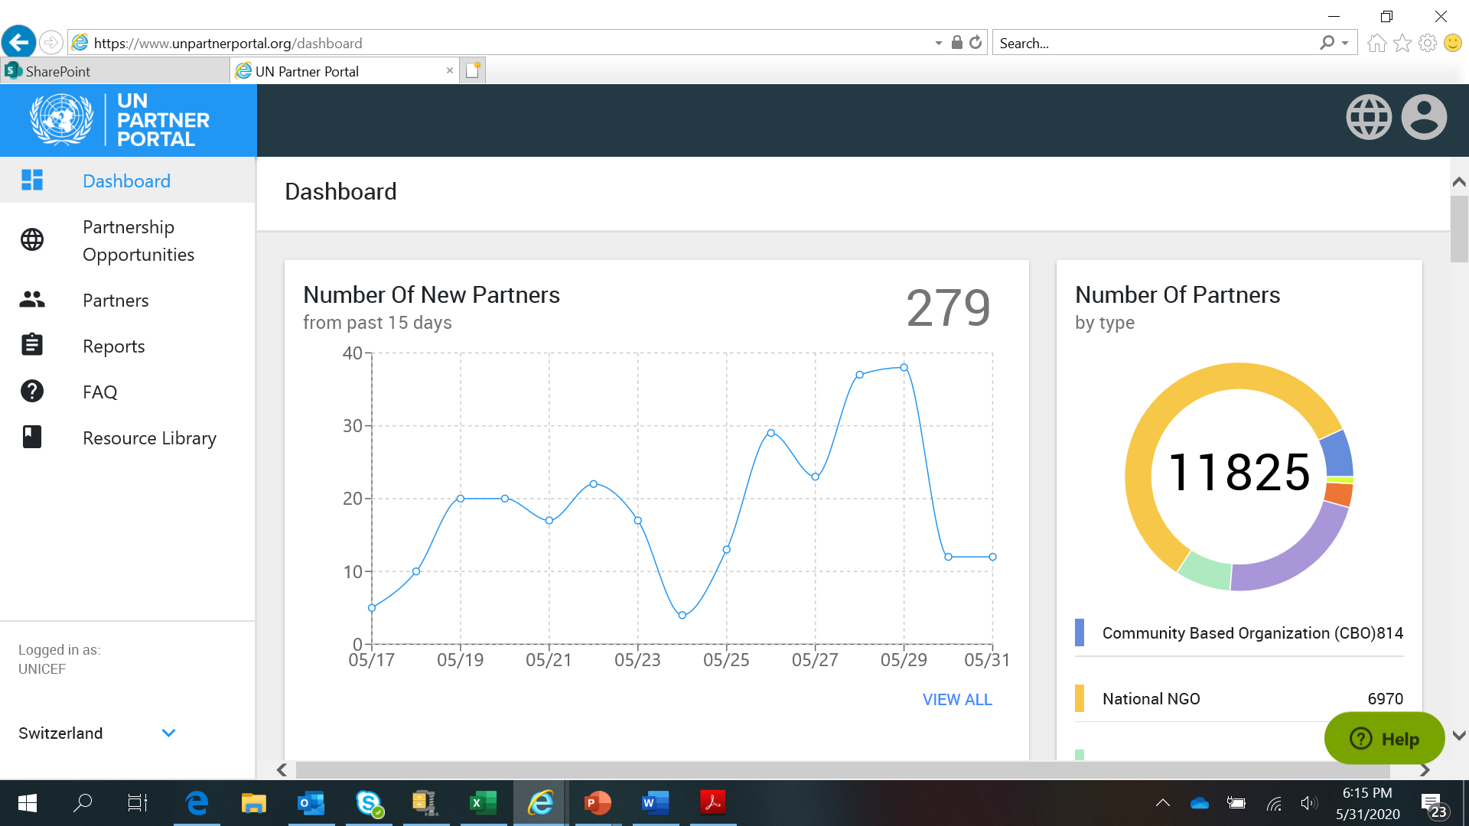
Promotion of principled partnership
Programme flexibility with simplified requirements for no cost extensions
Provisions for core direct costs and overheads to be covered, equitable sharing of risk, and need for mutual accountability.
Ongoing dialogues with NGOs by some UN agencies ( UNICEF, WFP, UNHCR)
UN portal for CSOs as a common platform for UNICEF, WFP, UNFPA, UNHCR in design of programme

Slide 9
Enhancing leadership and coordination with local actors
Meaningful participation of local actors in country level coordination mechanisms mainly HCT and Cluster coordination structures.
International coordination connects with local (national and sub-national) coordination mechanisms.
Linkage between the global humanitarian response planning process and national response planning process.

Slide 10
Streamlining engagement with affected communities
Bring different and effective risk communication and communication strategies together in a coordinated manner.
Support existing local actors’ feedback / complaints mechanism and roll out the same instead of initiating new mechanisms.
Need to strengthen local level reporting mechanism for GBV and PSEA in a realistic way, with local actors capacitated to handle issues reported from these platforms confidentially.

Slide 11
Synergies with the Grand Bargain
Existing commitments by UN, INGOs, donors on localisation
Localisation Workstream has coordinated research, country missions, regional workshops, consolidated findings in a series of guidance notes
Value added – where advances require donors and international agencies to work together – especially on financing issues
Workstream plans- 2020-21
Clarify donor-intermediary arrangements on risk sharing
Promote country–level dialogue
High-level dialogue on humanitarian-development gap in capacity funding
Support for progress of pooled funds

Slide 12
Synergies within IASC
Results Group 1 – promoting localization of coordination mechanisms
Results Group 2 - Advancing local level community engagement with local actors
Results Group 3 - Advocacy – addressing CTE and sanctions which hinder effective localization
Results Group 4 - Humanitarian – Development – local government and local economy, system strengthening
Results Group 5 – flexibility of funding and harmonization of due diligence and reporting
Gender Reference Group – local gender groups including local women organizations, and people living with disability.
Global Cluster Coordinators Group – coordination mechanisms.

Slide 13
Considerations for Moving Forward
Clarify accountabilities for HCT and HC commitment on localization and local actors representation in national and sub national level coordination
Advance solutions on duty of care issues (medevac and in-country health support to humanitarian staff)
Conduct lessons learned/best practices on the impact of CTE and sanctions on local actors in the COVID-19 context
Advocate for flexibility of funding from donors accompanied with quality reporting from local actors
Harmonize funding due diligence processes of donors and international agencies.
Ensure internal discussion/roll out within each agency’s internal structures (HQ-field) about the Interim Guidance

