Slide 1
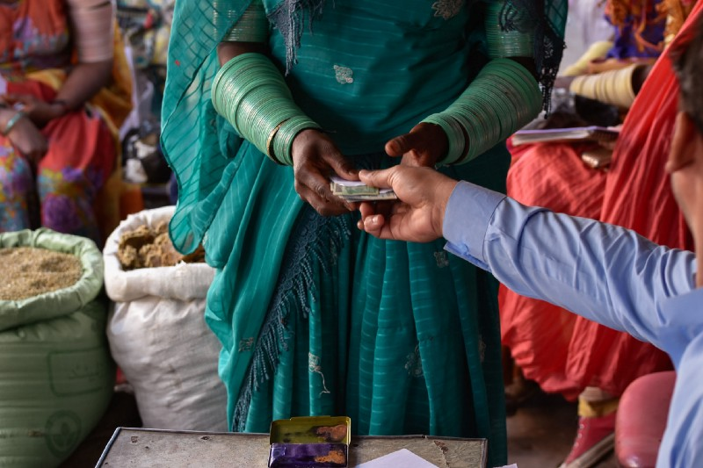
Grand Bargain Cash Workstream
Webinar Series
20-24 July, 2020
Data updated as of 31 December 2018

Slide 2
Adapting market monitoring to the COVID-19 context in Niger
Emily Sloane
Cash and Markets Technical Advisor
Economic Recovery & Development Unit
July 22, 2020

Slide 3
Context
Diffa region, Niger, Lake Chad crisis
E-voucher food assistance programs for refugees, IDPs and host communities
Long-time market monitoring, several (MARKit-inspired) improvements in 2017:
Reduced # of commodities monitored
Adopted improved digital data collection system
Added several non-price indicators
Notes:
12 commodities
5-6 markets (focus on IRC intervention areas)
Continued relevance of non-price indicators
Weekly-monthly data collection
Price data helps team build margin into vendor contracts

Slide 4
Adapting data collection in the COVID era
Shift to phone-based data collection
Combination of CommCare and paper questionnaires
Gradually resuming in-person interviews, using PPE + social distancing
In parallel, conducted household survey on impacts of COVID impacts, including questions on markets
Notes:
Advantages of market monitoring:
Commonplace
Relatively light
Familiar
Routine

Slide 5
Initial COVID-era market findings: process & data
Network /connection problems interrupted phone-based data collection
Modest price changes:
Cowpeas
Staple grains
Exchange rate

Slide 6
Implications of findings
COVID (and specifically COVID-related reductions in transport) = one of several factors contributing to modest increases in the prices of staple cereals
Markets still functioning and able to supply basic food items at a reasonable price
E-vouchers for food still appropriate

