Slide 1
Grand Bargain Annual Independent Report 2020
Annual Meeting 2020
23 June
Notes:
Hello, everyone – it’s a pleasure to be with you today. Before I move on to the report headlines, I wanted to say a few words about the methodology.
We used the same approach and methodology as for the previous three annual reports to ensure some degree of comparability. This report covers signatory activities during the period January – December 2019. We reviewed the 58 Self reports that were submitted by end of February deadline (there are 62 signatories now in total). This 95% submission rate was higher than last year; we also reviewed the co-conveners reports from all 8 workstreams; interviewed 54 signatories and 17 co-conveners; reviewed available literature; and analyzed the preliminary results from the 2019 round of perception surveys conducted by GTS/OECD; and reviewing the preliminary results of a survey conducted by NEAR of its National and Local NGO members to which there were 93 responses.

Slide 2
2019: a year of consolidation and continued progress
A unique platform for strategic collaboration
Improved leadership and governance
Wealth of positive practices in key areas
Increased action and interest at field level
Notes:
Some headlines for 2019:
It is was evident that the vast majority of signatories continue to see the GB as a unique and valuable platform for strategic collaboration between donors, UN, RCRCM, NGOs – on the key issues affecting the international humanitarian sector.
Responding to our past recommendations, there was improved leadership and governance,… with the new EP having brought a new energy and impetus for change, the FG having adopted a more action-orientated approach and the enlarged Secretariat able to provide increased support to signatories including facilitating greater information-sharing.
There was an impressive range of positive practice emerging at HQ and country level – in localisation, in reducing management costs, in quality funding, in harmonised reporting and in nexus programming and approaches.
And there was increased action by and interest from country level actors to deliver under the Grand Bargain.

Slide 3
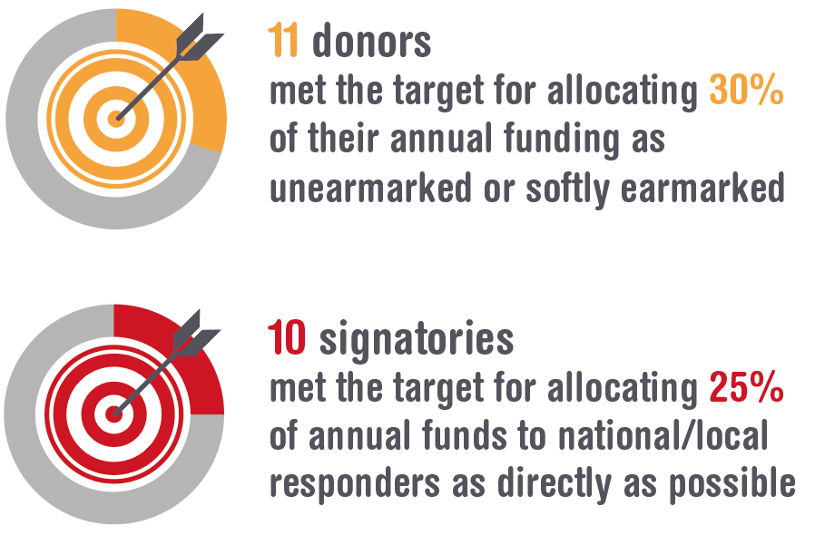
Shifting norms and operational practice
More cash assistance
More funding and support for local responders
Improved intersectoral needs analysis
More flexible funding
Notes:
There was clear progress towards objectives in four key areas or workstreams:
1). The volume of cash programming continued to increase almost doubling since 2016. This increase was supported by greater understanding of and investments in the quality of cash programmes.
2). More funding was provided to local actors and more done through a range of modalities to strengthen their capacities to do more and do it better – with 10 signatories (compared to 7 in 2018) reporting meeting or exceeding the 25% target for provision of funding to local responders as directly as possible.
3). The quality of joint intersectoral needs analysis improved – with 75% of HNOs for the 2020 HPC assessed as scoring 75% or above – the HNOs for Libya, Somalia and CAR were scored the highest.
4). And more donors – 11 in total - reported meeting or exceeding the target of 30% of their humanitarian funding allocated as unearmarked or softly earmarked in 2019 – with available data also suggesting that a greater proportion of this funding was unearmarked, rather than softly earmarked.

Slide 4
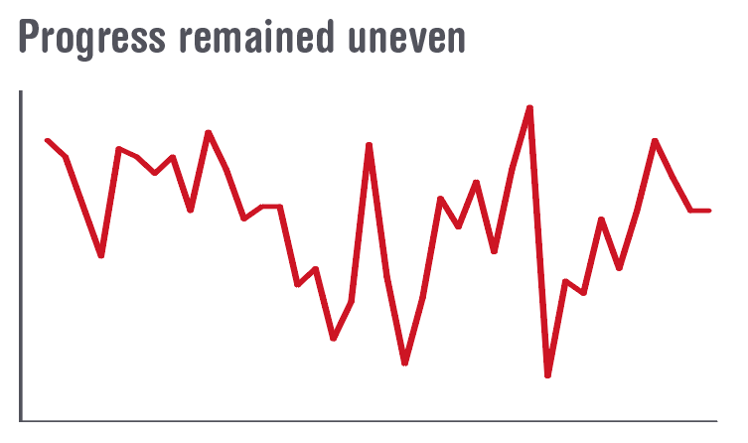
But….
Lack of progress on harmonized reporting and reducing management costs
Failure to take emerging good practice to scale
Lack of strategic focus on areas which would drive reform of the system
Notes:
But – as in previous years – progress was very uneven – with clear gaps and weaknesses in performance in some workstreams, by signatories and in relation to specific commitments, including the core commitments.
1). There was little progress on reducing the number of individual donor assessments and there was no holistic approach to reducing costs and increasing efficiencies across the humanitarian system.
2). Though there is now proof of concept for harmonized reporting – that a simplified template can satisfy donor requirements while also reducing the reporting burden on partners -, by end 2019 only 6 signatories reported using the 8+3 template for their downstream partners globally
3). As mentioned earlier, there is a wealth of positive practice emerging– many examples highlighted in this and past years’ reports – but few of these examples are being taken to scale, even where there is clear evidence of the results or return on these investments.
4). And there’s a lack of strategic focus on the 3 or 4 areas in which all signatories have a vested interest – the core commitments have enabled some degree of focus but many were not particularly strategic and in consequence the majority of signatories continue to determine their own priorities - with the result that efforts are spread too thinly to achieve systemwide change.

Slide 5
Cash workstream continues to outperform others
Continued strong leadership of the workstream
Growth in use & volume of cash
Improvements in effectiveness & efficiency of different modalities
More strategic use of cash
Notes:
I now want to focus on the headlines for Workstream 3 on cash:
Overall, the workstream continued to outperform all the others. Leadership of the workstream has remained strong. The UK and WFP have continued investing in their convening role, and the active participation and substantive investments from a large number of individual signatories, many of which have taken a lead on specific tasks, issues or sub-groups, has enabled the workstream to make important progress against their workplan in key areas
There was continuing and impressive growth in the use of cash programming in humanitarian settings, with the near doubling in the volume of cash and voucher assistance between 2016 and 2019 as just mentioned.
Significant efforts were also made to improve the effectiveness and efficiency of different modalities.
Guidance on tracking cash and vouchers was developed by subgroup on efficiency and effectiveness
Enhancements were made to the SCAN tool
Improved guidance was developed by IRC and USAID on harmonising cost-efficiency methodologies (3.3 & 3.4)
Outcome indicators for MPC were developed through a highly inclusive process, have been agreed & are being tested – these will enable signatories to monitor whether cash has met basic needs in a way that cuts across different sectors.
These initiatives will help build evidence on the characteristics of different modalities, but will need to be complemented with data on outcomes to assess cost-effectiveness and value for money to more accurately inform future funding and design decisions.
Individual signatories also explained how they are using cash in more strategic ways to advance other objectives.
CRS reported on its focus in 2019 on promoting cash programming through its local NGO partners.
Several signatories reported on their use of national social assistance programmes to help deliver cash at scale in emergencies. For example in Yemen, UNICEF and the World Bank, with support from the UK through the Yemen Emergency Multi-Donor Trust Fund, has capitalised on the existing Social Welfare Fund – a long-term social assistance programme – to deliver emergency cash support at scale. The project has delivered five rounds of emergency cash to 1.5 million vulnerable households (around 9 million people). Responding to the risks involved in scaling up emergency cash assistance in a highly dynamic conflict environment, the programme embedded a strong risk mitigation focus including establishing a dedicated project management unit in UNICEF.

Slide 6
Signatories reporting increases in cash programming in 2019
Notes:
From the data presented in the self-reports, it is clear that cash, and to a lesser extent vouchers, is increasingly being routinely considered and embedded within individual signatories’ operations and in inter-agency processes. The three largest UN humanitarian agencies all reported significant increases in the use of cash programming. The World Bank remained the largest programming agency in relation to cash, providing $2.7 billion for social safety net programmes in fragile and conflict-affected states in 2019.
Many aid organisations reported on their ongoing investments in internal capacities to scale up their use of cash assistance through dedicating teams at headquarters, enhancing financial and administrative systems, and building country office staff capacities to design and implement effective cash programmes.
At a collective level, 16 out of 25 HRPs in 2019 included specific plans for the use of multi-purpose cash, according to preliminary analysis by OCHA.
Donors too have increased their support for cash programming, with ECHO reporting that, according to provisional figures, 37% of the humanitarian assistance it funds is in the form of cash transfers, compared to 35% in 2018.
In 2019, the CERF enabled the provision of cash and voucher assistance to 2.6 million people in 32 countries, with a total value of $48.7 million. The proportion of this that was programmed as unrestricted cash and voucher assistance increased significantly, from 45% in 2018 to 79% in 2019.

Slide 7
Other important areas of progress
Increased focus on addressing data risks and enhancing data protection
Efforts to enhance the use of cash and vouchers in specific programme areas (health, GBV, protection, etc)
Continued to build momentum on gender-responsive cash programming
Began building links with localisation workstream
Some progress on operational coordination at country level and collaboration within constituencies
Notes:
There were several other areas where important progress has been made.
Although more needs to be done, there’s also been an increased focus on finding ways to better address data risks and enhance data protection in relation to cash programming in response to growing concerns around the large-scale use of biometric registration systems and scaled up partnerships with private sector financial service providers. (Example: ICRC’s new biometrics policy)
There were also efforts to enhance the use of cash and vouchers in specific programme areas:
WHO reported on the work of the Global Health Cluster to improve guidance on the use of cash and vouchers in health programming, including the development of a dedicated module for the learning platform, the inclusion of sections on cash programming in the revised guidelines and the development of technical guidance on a minimum expenditure basket for cash programming in health.
IRC developed the ‘Safer Cash Toolkit’ to help organisations make informed decisions on how to design, implement and adjust CVA programmes to prevent and minimise harm;
Care International produced a compendium on integrating gender-based violence risk mitigation and prevention efforts in cash programming, to accompany the 2015 IASC Guidelines for integrating gender-based violence interventions in humanitarian action.
The workstream has continued to build momentum on gender-responsive cash programming. The WS sub-group produced further evidence of and guidance on gender and cash in 2019, including Care International’s participatory research on gender-sensitive cash and voucher assistance in five countries and a related learning event, and UN Women’s publication of a discussion paper on the effects of cash-based interventions on gender outcomes, and a guidance note on promoting gender equality.
Links with other workstreams focused on the establishment of the new sub-group on cash and localisation, in collaboration with workstream 2. And Coordination with CaLP and other mechanisms related to cash programming continued, with a clear division of labour and complementary efforts to address key challenges.
In terms of existing operational coordination, OCHA provided guidance, tools and technical support on integrating cash into country coordination structures and the HPC, HNO and HRPs, with functional links established between country-level Inter-Cluster Coordination Groups (ICCGs) and Cash Working Groups (CWGs) in 88% of HCTs. The standardised terms of reference for ICCGs, including articulation of the role of cash working groups, were finalised, and agreement was reached to include an optional separate section on multi-purpose cash in HRPs. This latter action had been a sticking point as cluster lead agencies were reluctant to have cash dealt with outside their mechanisms. According to data from OCHA, of the 20 HRPs for 2020 that were available by 1 June 2020, 16 (80%) included a separate section on multi-purpose cash programming.
Draft standardised terms of reference for CWGs were developed by the Global Cluster Coordination Group (GCCG) and subsequently amended by CaLP, but were not endorsed by end-2019 due to lack of agreement on a number of issues, including whether they should have a ‘strategic’ as well as a technical role
Collaboration within constituency groups appears to have increased:
INGOs - The CEOs of the 15 NGO members of the CCD network issued a formal Letter of Intent in June 2019 reiterating a commitment to collaboration in 10 countries by June 2020.
UN – CCS signatories made progress under three of its themes: procurement, interoperability and programming.
Donors – 10 donor signatories issued a joint statement setting out ‘a shared vision for use of cash in humanitarian action
These groups will be reporting on progress during the course of this week so I won’t say more except that we are interested to know about how these groups are collaborating with each other, especially the CCD and CCS.

Slide 8
But challenges remain…
No progress in the establishment of a global agreement on the operational coordination of cash programming
Operations not being informed by progress being made at headquarters on technical issues, standard-setting and building the evidence base
Cash WS still not making sufficient strategic & operational links with local responders
Tension between increasing delivery of humanitarian cash through govt SP mechanisms & counter-terrorism policies
Notes:
A number of issues and challenges around cash programming were raised by signatories and other stakeholders during interviews. Key amongst these is that there remains a glaring gap in relation to the establishment of a global agreement on the operational coordination of cash programming. That this objective is being thwarted mainly by inter-agency politics rather than technical issues is widely acknowledged by signatories, but there was insufficient strategic-level engagement to resolve it in 2019.
Concerns were also expressed that the progress being made at headquarters on technical issues, standard-setting and building the evidence base was not reaching country or crisis level to inform operations; that the workstream (and other cash coordination mechanisms including CaLP) were too exclusive and still not making sufficient strategic and operational links with local responders, despite the important role that many play in cash programming; and that the increasing push from donors for large-scale cash programmes risked marginalising local responders. The workstream recognised the need for a greater diversity of voices in policy debates and in the coordination of cash programming, but efforts to address this, such as holding the annual workshop in the global South and inviting more Southern participants to meetings, are hampered by the lack of budget for the workstream. At country level, the increasing use of shock-responsive social protection mechanisms to deliver emergency cash support is seen by some signatories as one potential way to ensure that local responders remain at the forefront (as evidenced in UNICEF’s links with the Social Welfare Fund in Yemen). Some signatories, and research conducted by CaLP, also raised concerns that the risks of cash and voucher assistance were amplified by states’ counter-terrorism policies, resulting in lower tolerance of cash compared to in-kind assistance among some donors.
* In the NEAR survey, 62% of local and national NGO respondents stated that they ran cash programmes in 2019.

Slide 9
Ramping up success by 2021
Reach and enact a global agreement on cash coordination;
Upscale funding to strengthen capacities of local responders;
Roll-out the harmonised narrative reporting template to downstream partners globally; and
Re-define ‘quality’ funding.
Notes:
Ramping up success by end 2021 – in our view the means and the opportunity are there to achieve a step-change, even a system-wide shift, in at least four areas:
In each of these areas, we think sufficient technical progress has been made, that there is clarity on what is needed next to achieve overall success, and that there is a strong imperative for change – but this will only be delivered if the requisite political will can be harnessed– i.e. if signatories make the necessary investments and take the risks to move forward.
First: Cash assistance
The scaling up of cash assistance has been hugely impressive – not just the increase in volume but also the fact that this increase is happening across the system, from all types of signatories – largest to the smallest; that it is being done in a considered way, with efforts to institute common standards, explore and mitigate risks to affected populations as well as to each actor up the chain; and that it has been done in a collaborative way with donors, UN, RCRCM, NGOs working together to achieve this success. Cash assistance, particularly multi-purpose cash, could bring a transformative shift not just in terms of efficiencies but also in shifting power to affected populations. Realising this transformation requires a clear agreement on cash coordination at global level – WS 3 decided to leave this to the IASC in 2018 but progress since has been too slow. We now suggest that you use the GB to pressure IASC agencies to reach and enact a global agreement on coordination of cash assistance that provides predictable leadership, a clear division of labour, and ensures common standards at global and country levels. This step forward could enable the transformation of humanitarian action that cash assistance has long promised.
We can’t ignore the Covid-19 pandemic, which is both a threat and an opportunity. It is compounding existing vulnerabilities of people already affected by conflict and disaster and exerting additional pressure on already stretched national and local capacities, as well as those of international aid actors. But it also creates an imperative for a more efficient and effective response, for much smarter use of funding, more creative ways to address needs and more collaborative approaches from all aid actors – international and national. In this respect it could act as a game-changer for international humanitarian action. COVID-19 - cash assistance has huge advantages in this crisis but particularly so in relation to addressing the socio-economic impact – there are already efforts underway by affected states and aid organisations alike (including supported by many of you) to integrate or coordinate emergency cash interventions with existing social safety nets – ensuring that the most vulnerable are able to receive assistance quickly and effectively.
Second: Localisation
Important progress has been achieved on localisation in the last four years, with normative developments and a wealth of positive practice documented. Realising the high expectations that have been generated around localising responses will require a more balanced approach that combines delivering more money to local responders with helping them strengthen their capacities to manage this extra funding. Long-standing practice by a number of signatories evidences the returns that can be gained on investments in capacity strengthening – enabling frontline responders to directly access international funding, expand their programmes and better manage their and their upstream partners risks. The evidence is there – now we need donors to start providing or rapidly upscale funding that enables institution-strengthening efforts and which allocates an appropriate amount for local actors’ overhead costs to enable continuity of their operations and their institutional growth.
Third: Harmonised reporting
The harmonised reporting template developed under WS 9 has been tested, evaluated and finalised. The signatories need to now adopt it without reservation in order to reap the benefits that it offers for downstream partners. Not always considered very ‘transformative’, but delivering on this core commitment by summer 2021 would be a key measure of success of the GB.
Fourth: Quality funding
There has been a lot of progress since 2016, with data suggesting increases in the number of donors providing multi-year commitments and/or increasing the volume of unearmarked or softly earmarked funding as a proportion of their overall funding. But this has not yet achieved the results anticipated or hoped for. A different approach is required – a redefining of what quality funding actually means. Rather than tackling MY and flexible funding as two separate but loosely connected elements, a more strategic approach is necessary – one that combines different levels of flexibility with different levels of predictability - this would be more pragmatic given the geopolitical environment that we find ourselves in but more importantly it could ensure that funding can be adapted to the specific response, context, and/or programme.

Slide 10
HPG is one of the world’s leading independent research teams working on humanitarian issues. We are dedicated to improving humanitarian policy and practice through a combination of high-quality research, dialogue and debate.
Subscribe to our newsletter: odi.org/newsletter-sign-up

