Slide 1
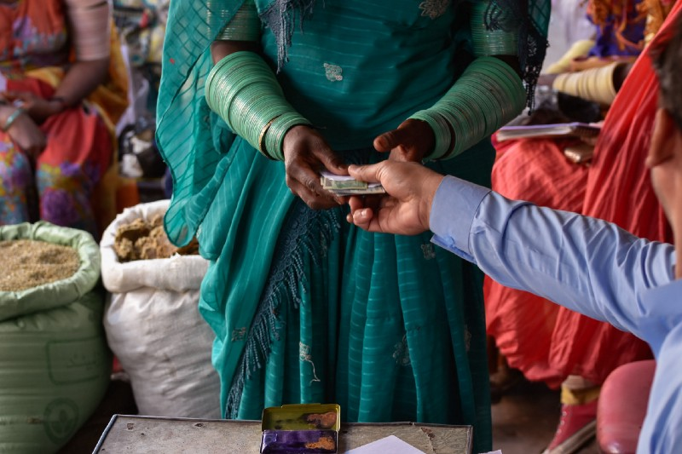
Grand Bargain Cash Workstream
Webinar Series
20-24 July, 2020
Data updated as of 31 December 2018

Slide 2
Linking Humanitarian Cash and Social Protection GB Subgroup
Aim of the webinar:
To update the group on the status of the revised work-plan, and the process that has been undertaken this year to consult on the WP
To update the WP conceived in 2019, to ensure feasibility and agree responsibility for agreed activities
To present the discussion note on Knowledge Management and Learning (KML) in relation Engagement Area 3 in WP and agree on/amend the WP.
To explain how cases studies (Activity 3.5 in WP) exploring themes related to Covid-19 and programming will be undertaken

Slide 3
Linking Hum Cash and SP Subgroup: Workplan Consultations
Scope of work proposed in 2019 was too ambitious
The subgroup should be actively convened (needs resources)
All activities included should clearly demonstrate the added value of the subgroup (not single members)
Some activities would benefit from further definition
PROCESS: Invitation of all subgroup members to phone interview or email survey
COVERAGE: 27 members participated
CONSULTATIONS:
status of any agreed workplan activities;
interest to lead or contribute to listed workplan activities;
other activities planned in 2020-21 that might fit objectives and engagement areas of the subgroup;
how the subgroup could be managed.
1
2
3
4

Slide 4
Linking Hum Cash and SP Subgroup: Final Draft Workplan
What’s changed
Removal of non-started, poorly defined subgroup activities
For each activity the plan includes
Status
What can be added?
Any other activities that are missing and that members agree are a priority
Timeline 2020-21
Funding
Lead and contributors
Addition of new proposed activities

Slide 5
Knowledge Management and Learning: Background – WP Engagement Area 3
April 2019 meeting: KML priorities. UNICEF committed resources
Oct 2019 start of consultancy with the objectives to:
Assess KML needs of hum practitioners, including appropriate products and platforms (result: discussion note)
Begin KML work (webinars, discussion threads; started Dec 2019)
Make recommendations and a draft action plan for KML
March 2020: ramped up with COVID
Notes:
KML was one of the areas of priority with some tasks listed from the April 2019 meeting. UNICEF committed to resourcing and leading on this activity.
Isabelle and I were hired to take on the work in Oct 2019 with the following objectives (read slide).
Sub group members were involved in the consultations that took place to write the assessment report on knowledge gaps in the SP/HCT space. Key Informant Interviews (KIIs) with 18 humanitarian or social protection stakeholders actively engaged on this topic. These consisted of representatives from the RC/RC movement (2); INGOs (2); Donors (6); UN agencies (6) and CaLP (2). We also had a separate technical KM platform discussions with CaLP and SP.org. We used an analysis framework which was taking the OPM and CaLP studies that had been done at that time (so SRSP and HCTs) and shoe horned needs into that.
We produced a discussion note that you all have which has NOT been revised. There was a separate action plan also developed which has been incorporated into the work Gaby has done to have one integrated plan.
Because of the basis we had already established, we were able to ramp up VERY quickly for COVID. Lois is taking that work forward and it is reflected in the work plan.

Slide 6
Main KML needs
Notes:
In purple you have some FOUNDATIONAL themes...concepts means: What is SP (including a life cycle approach, social transfers versus cash transfers etc)?
The role of the government in SP and humanitarian response
What does shock-responsive mean/when is a system shock-responsive?
What does linking CVA to SP mean, in different contexts?
Understand how SP links with development policies (i.e. macroeconomic and labour market).
This theme was highlighted as a priority across all KIIs, in particular the need for common conceptual frameworks as a foundation for collaboration between both sectors.
Options for linking: Specifically, the need for a clear way of defining entry points was identified by donors and NGOs, as a foundation for collaboration between both sectors. The interviews reflected the limitations of considering linking options in a categorical way (i.e. the OPM categorisation) and rather consider which parts of the system can be used, and how.
Institutional environment: The need for humanitarians to better understand governments’ mandates and responsibilities was raised by both SP and humanitarian informants as a foundation for collaboration between both sectors. (The GB webinar that we co hosted with CaLP to launch their high level SP CVA paper really doubled down on this aspect---understand who and what and how of government).
Then we have other categories (you can ignore the colours…we used those to differentiate which product was better suited for which topic i.e webinars, discussion threads etc).
SINCE COVID: leadership, coordination, delivery, joint funding, the need for hum and dev actors to understand how each side functions (highlighted in the newsletters; we ran a LIGHT touch update to make our products such as the webianrs, newsletters and case studies immediately relevant…) so these give an idea when push comes to shove, what are the priority needs.

Slide 7
Knowledge Management and Learning Products and Platforms
KML platforms: CaLP and SP.org
Products
Webinars
Discussion groups
Face-to-face events
Training
Newsletters
Standards, tools and guidance
Specialised technical support
Evidence centre library
Evidence centre research
Mapping (3W)
Blogs/podcasts/social media
Notes:
We assessed the different KM platforms and forums available. The two most obvious ones that we dug into deeper were CaLP and SP.org (we looked at ALNAP, RC Cash Hub, BASIC facility, WB forums).
The products are a mix of what we know KML platforms offer and what we heard from KIs as important methods to get information out. We took each one and put high level actions against it (see page 8 of discussion note). This has been synthesized further with Gaby and integrated into the overall plan.

Slide 8
Impact
Links between humanitarian programmes and existing SP systems, legislation and infrastructure are built to the greatest extent possible
From State of the World’s cash report 2 (SoWC2),
Outcomes
Dialogue between SP and humanitarian practitioners is strengthened and maintained
The best knowledge on linking CVA and SP is easily accessible and useful to humanitarian actors
The evidence base for linking CVA and SP is strengthened in priority areas for policy and practice
The quality of linkages between CVA and SP is strengthened through common standards and tools
Humanitarian practitioners feel confident to systematically consider the relevance of linking CVA with SP
Measure of the relationship between the KML activities/outputs and the impact
Preconditions
Consistent leadership of the Grand Bargain sub-group on linking SP and humanitarian cash
Development and coordination of a joint action plan for the sub-group
Appointment of a focal person for the implementation of action plan
Creation of an intra-agency subgroup (champions) to support the action plan
Agreements with CaLP and SP.org on KM products
Ongoing refinement of KML audience needs
Outputs
To be determined
Collectively defined based on agreements on the roles and responsibilities for taking forwards these activities
Activities
Webinars: Organise monthly webinars
Discussion Threads: Organise a monthly discussion thread on a priority topic
Face to Face Events: Organise 4 face to face events
Training: Develop a common competency framework as a basis for upskilling humanitarian actors to work in SP/CVA
Newsletters: Use newsletters as means of knowledge dissemination
Standards, Tools and Guidance: Consolidate and harmonise standards, tools and guidance focused on common frameworks for engagement in the topic
Specialised Technical Support: Maintain and improve roster of people with a mixed profile required for advice/implementation of SP and CVA
Evidence (Library): Upload relevant resources to the CaLP and SP.org platforms
Evidence (Research): Support creation of “spaces” for research collaboration on the topic
Mapping: Support the CaLP led 3W mapping with relevant examples and materials
Blogs/Podcasts/Social Media: Maintain, develop and cross post using similar taxonomy
Concrete actions the subgroup proposes to take forwards based on the findings of the KML assessment summarised above. They are intended as a basis for coalescing stakeholders to contribute to a joint action plan for taking them forwards.
Notes:
We have taken the statement from the SoWC (it’s hopefully still the same?). To keep a consistent link between the different initiatives.
The pre conditions are mostly met. We did a light touch on refining audience needs with COVID.
Ongoing discussions with CaLP and SP.org on KM products (for webinars SP.org).
Good to discuss the outcomes listed and see if they still match.
The activities are mostly incorporated into the work plan. What we want to do with the others listed is up to this group. 5 on newsletters wasn’t part of the plan that we do this (rather that we feed into others work) but for now, we are producing newsletters. Good to see that Ugo’s newsletter now takes fragility into account and we cross reference SP.org’s weekly newsletter and they cross reference us.
Suggestion on outputs is to define these as part of the work plan and who takes on which responsibility. Webinars is clear as is case studies and newsletter.

Slide 9
Discussion: 25 minutes
Questions of clarification? (5 minutes)
Broadly reflective of your experience? (3 minutes)
Which are the priorities activities and sequencing? (quick fire 5 minutes)
What are agencies doing to share the KML activities (webinar, newsletter, advocacy pieces etc) with their regional and country colleagues? Do we have any good practices on this? How can we strengthen the engagement on KML with practitioners based in countries (12 minutes)

Slide 10
Case Study Overview – WP Activity 3.5
Overarching Theme:
Illustrations of successes and challenges in linking HCT and SP in response to COVID-19.
CS 1 - Topic: Policy
CS 2 -Topic: Design and Operations/ Implementation
CS 3 - Topic: Design
CS 4 - Topic: Operations/ Implementation
CS 5 - Topic: Operations/ Implementation
Each case study:
- Multi-Agency (4 SG member agencies)
- Up to four contexts/countries
- 8-10 KI interviews +FGDs
Topics:
POLICY – DESIGN - IMPLEMENTATION

Slide 11
Case Study Overview – WP Activity 3.5
Case study overview
Policy | Design and operations/ implementation | Design | Operations/ implementation | Operations/ implementation
Financing | Vulnerability and poverty assessment | Targeting | Outreach, comms and messaging | Information systems
Legal and Policy frameworks/SOPs/ agreements | Market and price analysis | Transfer value, frequency and timeliness | Do no harm, protection and grievance | Registration and enrolment
Governance and coordination | Monitoring and evidence | Conditionality | Scaling down and exit options | Payments and delivery
Capacity building |  | Purpose and links with intended outcomes

Slide 12
Case Study Development – Methodology and Process
Sub-Group KML Consultant
Methodology development
Guidance to co-leads
Sub-Group Members
One SG member lead for each case study
Setting up and undertaking interviews/FGDs – ensuring wide representation
Quality control for all case studies
Sourcing documents to review
Writing content
Assistance in interviews if required
Providing case study format

Slide 13
Case Studies
Next steps:
Please contact Lois Austin at loisrabbit@aol.com indicating whether you are interested in:
Co-leading a case study
Contributing to a case study
Deadline: Friday 31 July 2020

