Slide 1
Grand Bargain Cash Workstream
Webinar Series
20-24 July, 2020
Data updated as of 31 December 2018

Slide 2
MARKit The Market Monitoring, Analysis and Response Kit
Grand Bargain Cash Workstream Webinar Series
22 July, 2020

Slide 3
MARKit
MARKET MONITORING, ANALYSIS AND RESPONSE KIT
Webinar Sessions | Presenter
Introduction | Ruco Van Der Merwe, Food Security and Markets Advisor (USDA PASA), BHA, USAID
MARKit Overview | Megan McGlinchy, Senior Technical Advisor for Local Markets, CRS
Field Example – CRS Ethiopia | Ashenafi Alemu, Early Warning and DRR Technical Advisor, CRS ET
Field Example – IRC Niger | Emily Sloane, Cash and Markets Technical Advisor Economic Recovery & Development Unit, IRC
Discussion | All panelists and participants

Slide 4
Session Overview
MARKit objectives and principles
Lessons learned
Key changes in 2nd Edition
MARKit framework
Next steps

Slide 5
MARKit
MARKET MONITORING, ANALYSIS AND RESPONSE KIT
MARKit project launched in 2008
MARKit Manual published in 2015
CRS MARKit mentorship program and revision process in 2017-19
MARKit Manual, 2nd Edition, published 2020
MARKit Toolkit:
Manual (English and French)
Worksheets
Excel database with sample price data and instructions
Sample monthly MARKit report
Sample training and TOT materials

Slide 6
MARKit
MARKET MONITORING, ANALYSIS AND RESPONSE KIT
WHAT IS IT?
Project-level market monitoring framework that guides users to determine the causes of abnormal price changes and make program adjustments, as necessary.
OBJECTIVES:
Establish a harmonized approach to market monitoring.
Support evidence-based decision-making and project design.
Ensure programs remain responsive to changing market conditions.
Mitigate unintended impacts on market systems; “do no harm.”
Determine appropriate transfer values to meet identified needs.
Promote learning and good practices in food assistance and other resource transfer programs

Slide 7
MARKit
MARKET MONITORING, ANALYSIS AND RESPONSE KIT
PRINCIPLES:
Project-level market monitoring
Uses price changes as a signal to investigate potential market impacts
Guides users to determine the causes of price changes and see if any program adjustments need to be made
Relevant across resource transfer modalities
Mix of quantitative and qualitative analysis
Feasible for busy, non-economist project staff

Slide 8
Lessons Learned
 | Assumptions | Reality
Use of market monitoring | Market monitoring should be done regardless of the length of the program. | Quantitative price monitoring is most appropriate for projects > 6 months; qualitative analysis can still be useful for short programs and/or in data-poor contexts.
Objectives | “Do no harm” is the main reason for market monitoring. | “Ensuring program effectiveness” is a primary objective of market monitoring; so is “learning.”
Indicators | Price variation can be a signal to investigate market issues. | Price variation can be a signal to investigate market issues – but non-price indicators can be useful, too.
Level of analysis | Programs can be divided into “high-risk” and “low-risk,” each leading to different analyses. | Programs need “more monitoring” or “less monitoring” based on the risk of market impact – the difference is the amount of data needed, not the analysis.
Outcome | Program managers can adapt their program (including changing modalities) in response to changing market context. | Market monitoring can maintain/increase program effectiveness, even if leading only to small adjustments.

Slide 9
Lessons Learned, continued
Technically sound, overall useful
Main challenges to using MARKit are user-centered: too complicated, too long, too many markets; no one reads the whole thing, very few people used the worksheets
Secondary and historical data were rarely used, even when they are available; need more guidance on qualitative methods
Need to put more emphasis on proper set-up of the MARKit monitoring platform
Need easy database for easier data entry and analysis
MARKit is used for more than food programs, and particularly for cash transfer programs

Slide 10
Key Changes to 2nd Edition
Six original MARKit steps expanded and grouped into four phases
More focus on preparation and set-up
Updated risk section
Updated analysis section, with focus on quick visual analysis of database and graphs
Focus on qualitative and quantitative data and analysis
Expansion to non-food commodities and the MEB
Inclusion of optional non-price indicators
Increased emphasis on reporting and sharing information

Slide 11
MARKit Overview (2015)

Slide 12
MARKit Overview (2020)

Slide 13
Step 6.1: Identify Abnormal Price Changes
Following each round of data collection, conduct the following analyses on the newly entered data.
Analysis 1: In the database, highlight price change(s) that exceed the established threshold level(s).
Analysis 2: Compare the price change(s) against the seasonal price index and/or calendar.
Analysis 3: Compare the current nominal monthly prices of a commodity to its monthly price during the last three to five years.
Analysis 4: Compare monthly commodity prices in each intervention market with those in the regional source market.
Analysis 5: (Vouchers only) Compare monthly prices between participating and non‑participating vendors

Slide 14
Analysis 1: In the database, highlight price change(s) that exceed the established threshold level(s).

Slide 15
Analysis 2: Compare the price change(s) against the seasonal price index and/or calendar.

Slide 16
Analysis 3: Compare the current nominal monthly prices of a commodity to its monthly price during the last three to five years.

Slide 17
Analysis 4: Compare monthly commodity prices in each intervention market with those in the regional source market.

Slide 18
Analysis 5: (Vouchers only) Compare monthly prices between participating and non‑participating vendors

Slide 19
Is further analysis needed?

Slide 20
Step 6.2: Characterize Price Changes

Slide 21
Step 7: Investigate the Causes
Seasonality
Supply shocks
Demand shocks
Trader capacity/actions
Intervention
Global food prices
Policies
Inflation
Currency exchange rates
Fuel prices

Slide 22
Supply Shocks
Supply shocks result from changes in production levels and/or disruption to the movement of good along the supply chain.
Supply shocks can be a factor for any price changes observed.
Supply shocks can be local, regional or national, and they can affect a particular commodity or many commodities.
What is it?
Why is it a factor?
Analysis needed
How to know this is influencing observed price changes
Analysis | Data Requirements
Refer to baseline market system map for possible interruptions | Baseline market information
Conduct Key Informant interviews (see Worksheet 3 for guidance) with traders, and local partners/staff to understand disruptions to production and supply flows | Local informants, secondary reports, news reports

Slide 23
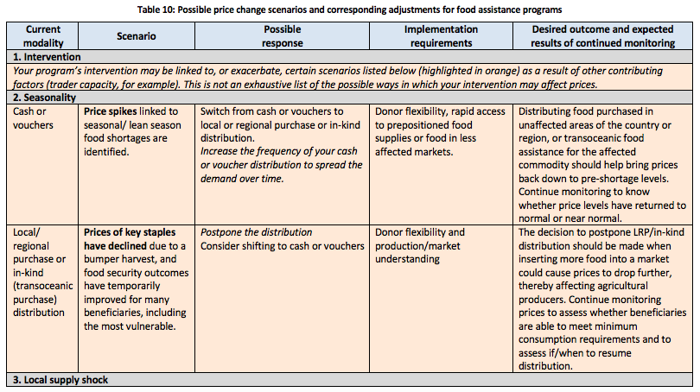
Step 9: Adjust as necessary
Adjustments to programs are determined by:
There are several levels of adjustments:
The severity and duration of the price change
The impact of the price change on beneficiaries and non-beneficiaries
The risk that continuing the intervention (as is) will further exacerbate the price change
What other organizations in the same area are doing or planning to do.
No adjustments to the current program
Minor adjustments to the program
Drastic adjustments needed

Slide 24
In the pipeline…
English and French MARKit Manuals are currently posted on the SEEP website.
Working with SEEP and the Markets in Crisis D-group to host an open-source MARKit page.
Nearly finalized template database and visuals in Excel and PowerBI.
Current grant from USAID IDEAL to develop Training of Trainer materials and deliver one (remote) TOT training.
If interested, contact Kassoum.Ouattara@crs.org or Megan.McGlinchy@crs.org

Slide 25
Thank you!

