Slide 1
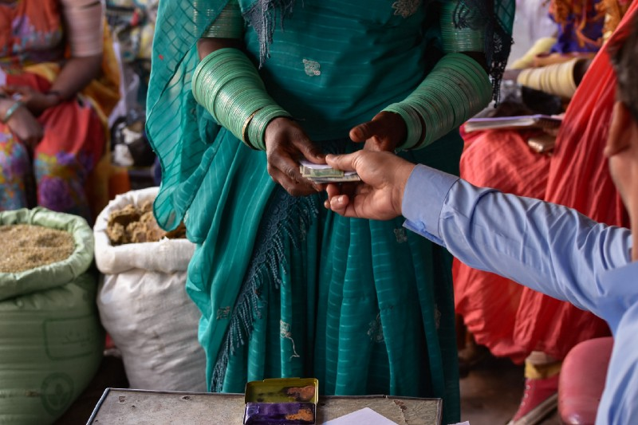

Grand Bargain Cash Workstream
Webinar Series
20-24 July, 2020
Who bridges the gap?
Accountability in Cash, Social Protection in COVID-19
Dr. Kathryn Taetzsch, World Vision
Data updated as of 31 December 2018

Slide 2
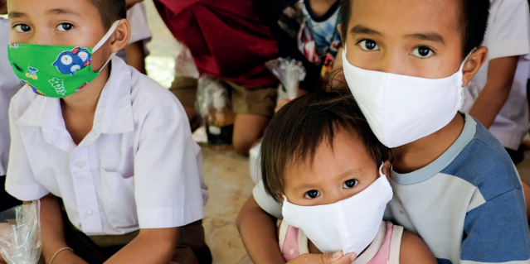
62%
of practitioners think humanitarian organisations are increasingly considering recipient perspectives in designing CVA (CaLP SOWC II)
Future of Change - Cash Transfers Scale-up to respond to COVID-19….
“Can we move away from extractive community feedback?”
“Interaction with and between citizens and decision makers that result in tangible, measurable change”
“Programme Outcomes – qualitative influence by individual and collective feedback”
“Shift from digi-tech & scale-up focus to people-centred (digital) inclusion and leadership”
CVA and Social Protection Transfers by Governments: “One would not have to choose one approach for all – but unbundling what fits capacities and strengths”
1.3 bn
vulnerable children have no access to social protection
Notes:
The report, Temporary Basic Income: Protecting Poor and Vulnerable People in Developing Countries estimates that it would cost from $199 billion per month to provide a time-bound, guaranteed basic income to the 2.7 billion people living below or just above the poverty line in 132 developing countries.
Creating a pathway from and complementarity between humanitarian cash, voucher programmes to longer-term government-led Social Protection assistance supports strengthening the humanitarian-development nexus and overall resilience and social cohesion. This, however, can only be effective if underpinned by community-led social accountability. Where government-led Social Protection mechanisms are being implemented, World Vision is currently strengthening social accountability with communities and children by facilitating constructive dialogue between local governments and communities to improve both the quantity and quality of basic social services
WV as a child focused agency aims at amplifying the voices of children affected by marginalization, poverty, disaster.
In FY 19, World Vision took a new and exciting step to ensure we more systematically listen to children and enable their voices to shape our decision making.
Global Field Operations leadership approved an integrated approach that connects how we collect feedback at the programme level by enabling children's voices to be heard at national office and partnership levels. This builds on our existing practices of Collecting and acting on feedback and complaints in all of our programme locations (part of the Programme Accountability Framework)
World Vision International implements social accountability programmes in 48 countries across the world, improving services for millions of people through local dialogues. Our main global model for social accountability, Citizen Voice and Action, employs targeted civic education, participatory community services scorecards and social audits of services,

Slide 3
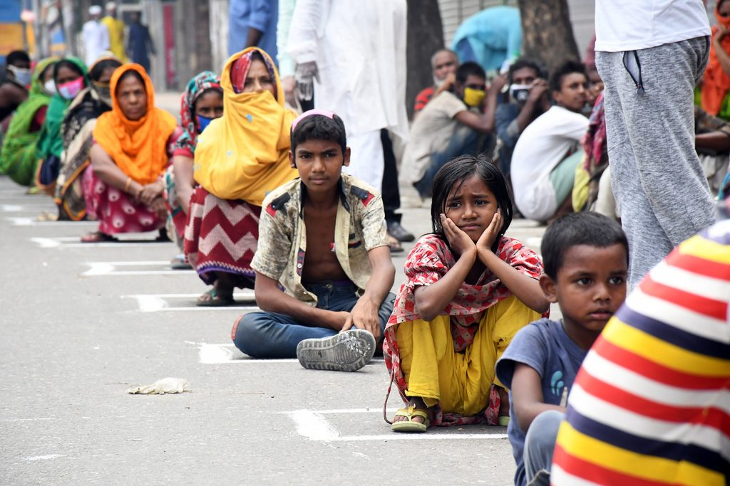
What Concerns? – Cash Transfers Scale-up to respond to COVID-19….
NGO’s Roles in Gap-Filling – What is “good enough” accountability in times of rapid cash-transfer scale up?
Are most vulnerable really reached?
Are intended outcomes, is quality impact achieved?
CVA now account for > 50% of Government’s Social Protection Assistance – how are transfer targeting, flows, effective reach monitored and reflected back through empowered community engagement, informing programming adaptations?
Digital & Remote create further disparity - operations, inclusiveness and ability to participate and engage effectively as affected individual/ population - more critical than ever
Community members queuing for food items in April 2020 to access relief assistance during C19-lockdown
Photo: SIPA/ USA – Atlantic Ccouncil
Notes:
CCD – Social Protection Brief C19 - https://reliefweb.int/report/world/ccd-social-protection-working-group-advocacy-response-covid-19
limited resources, increasing # of population vulnerable due to socio-economic and health impacts of C-19 - transparency, strong information provisioning on targeting, enrolment and access criteria for Social Protection assistance transfers by Governments and citizen engagement that NGOs can strongly leverage, will be critical to build social cohesion (esp. in Fragile Contexts affected by C19)
Concerns that the scale-up transfers have not reached the most vulnerable (link to upcoming CCD social protection paper) - Govts will be under scrutiny to demonstrate they can manage/deliver/account for huge financial sums they've been putting through their SP systems in response to C-19 - some effective accountability is essential;
NGO's agility and gap-filling through humanit. Cash as highlighted by the CCD, may bring tension of "what is good enough as accountability mechanism"?- At the same time, NGOs are able due to footprint, community mobilisation and agile humanitarian response mechanisms - to address immediate basic needs with MPCA to address existing gaps - in coordination with Governments & national CWG/ SPWGs - to ensure de-duplication of benefitting vulnerable community members that are still to be enrolled in Government led SP transfers (examples, Bangladesh, Kenya MPCAs etc)
The more citizens are empowered, the better they can advocate for themselves (WVI Bangladesh: Citizen Voice & Action) - e.g.through social accountability facilitation EVPRA - around the Government's SSN, those receiving information about the safety nets to which they were entitled, including pensions, disability allowances and child-focused social assistance, increased from 15% at the start of the project to 83% at the end of the project. Target beneficiary numbers accessing the Government’s SSNP at the start of the project were as low as 5 %, whereas at the end 74% of beneficiaries had accessed and benefitted from the Governments SSNP due to Citizen Voice and Action community empowerment activities
GoB had committed to scale up Social Protection Assistance Transfers for 4 Mio citizens – how payments can be effectively targeted at most vulnerable households remains a challenge.
https://www.atlanticcouncil.org/blogs/new-atlanticist/bangladeshs-covid-19-stimulus-leaving-the-most-vulnerable-behind/

Slide 4
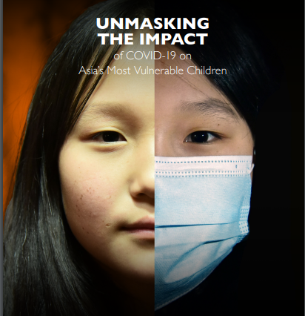
What Concerns? – Cash Transfers Scale-up to respond to COVID-19….
Nat. Governments – optimize targeting in social assistance transfers (urban, informal settlements – issues of documentation, birth certificates, refugees, migrants)
If Government SPs are meant to scale-up reach of poor HH…
  E.g. in Sri Lanka to 47 %, UNDP report with recent simulation data based on nat. HH surveys - showed that approx. 34% were likely to be excluded
Getting the right economic support to the right people is critical in the short-term
Notes:
CCD – Social Protection Brief C19 - https://reliefweb.int/report/world/ccd-social-protection-working-group-advocacy-response-covid-19
limited resources, increasing # of population vulnerable due to socio-economic and health impacts of C-19 - transparency, strong information provisioning on targeting, enrolment and access criteria for Social Protection assistance transfers by Governments and citizen engagement that NGOs can strongly leverage, will be critical to build social cohesion (esp. in Fragile Contexts affected by C19)
Concerns that the scale-up transfers have not reached the most vulnerable (link to upcoming CCD social protection paper) - Govts will be under scrutiny to demonstrate they can manage/deliver/account for huge financial sums they've been putting through their SP systems in response to C-19 - some effective accountability is essential;
NGO's agility and gap-filling through humanit. Cash as highlighted by the CCD, may bring tension of "what is good enough as accountability mechanism"?- At the same time, NGOs are able due to footprint, community mobilisation and agile humanitarian response mechanisms - to address immediate basic needs with MPCA to address existing gaps - in coordination with Governments & national CWG/ SPWGs - to ensure de-duplication of benefitting vulnerable community members that are still to be enrolled in Government led SP transfers (examples, Bangladesh, Kenya MPCAs etc)
The more citizens are empowered, the better they can advocate for themselves (WVI Bangladesh: Citizen Voice & Action) - e.g.through social accountability facilitation EVPRA - around the Government's SSN, those receiving information about the safety nets to which they were entitled, including pensions, disability allowances and child-focused social assistance, increased from 15% at the start of the project to 83% at the end of the project. Target beneficiary numbers accessing the Government’s SSNP at the start of the project were as low as 5 %, whereas at the end 74% of beneficiaries had accessed and benefitted from the Governments SSNP due to Citizen Voice and Action community empowerment activities
GoB had committed to scale up Social Protection Assistance Transfers for 4 Mio citizens – how payments can be effectively targeted at most vulnerable households remains a challenge.
https://www.atlanticcouncil.org/blogs/new-atlanticist/bangladeshs-covid-19-stimulus-leaving-the-most-vulnerable-behind/

Slide 5
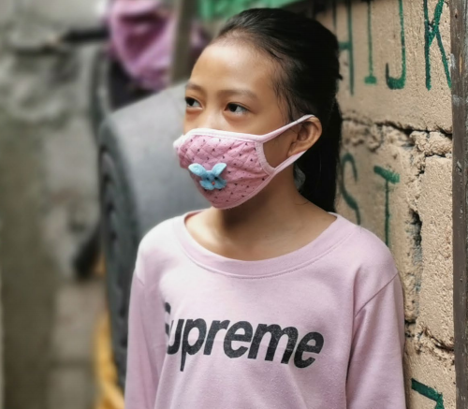
What Concerns? – Cash Transfers Scale-up to respond to COVID-19….
…even where government intends to reach the most vulnerable, they can – through administrative complexity or corruption – miss their intended target for relief…
Need for a
Change in power relations (CaLP, SOWC II)
Understanding government legal and policy frameworks, various ministries involved (Unmasking Impact Report, World Vision)
Support in strengthening systems (eg. health, education, social benefits)
Social accountability approaches like “Citizen, Voice and Action” have effectively proven to help trigger and sustain these. Methodology uses a strategic package of civic education, mini-social audits of service standards, participatory services scorecards, community led-advocacy and multi-level coalitions for change to achieve government accountability for better services.
Notes:
Ensuring those recipients of social protection have the information they need and a say in the relief and if it is reaching them, is both empowering, and critical to government efficiency and effectiveness in resource allocation.
Citizen Voice and Action (social accountability) works by:
“CVA works by changing power relations. It does so by using structured and transparent processes to organise collective opinion, which is harder to dismiss than individual opinions; by making the criteria for judgements transparent; by increasing the legitimacy of claims on the system; by empowering women; and by bringing different types and levels of decisionmakers into the process, such that different forms of authority are available to address different issues.”11 “CVA works by strengthening systems. That is, in this case, the boundaries of the health system at local level were expanded to include citizens and local government; component elements of the system were strengthened; relationships were established between various elements of the system; stronger information and resource flows were introduced within the system; and positive feedback loops supported ongoing action to improve system effectiveness.”12
https://www.wvi.org/sites/default/files/FINAL-Scaling-Social-Accountability-Jan-8-2019-2.pdf
Like many current responses hampered by the lockdown, adaptations are needed through technology applications. For example, some governments are using simple push and pull technology with WhatsApp. These can be adapted with simple templates for government to share critical information to communities, but, just as importantly, to give citizens a platform to reach government, in particular, social protection service providers. A wide array of issues need not be left to media to report by chance, such as lack of knowledge, access, life and death emergencies, police brutality, and more.
In the era of COVID-19, effective services like water, sanitation, and social protection are needed more than ever, but to function they need the ongoing support of information and citizen feedback. It is therefore not only about receiving immediate basic survival assistance – humanitarian cash transfers – to the most vulnerable – but ensuring appropriate targeting, registration, and strengthened social accountability when governments start providing social protection – top-up transfers to those affected by disaster or pandemic-shocks. Citizen engagement can be strengthened through crises as World Vision has evidenced in many humanitarian fragile and development contexts, enabling effective transfer and service support to those most in need, across the Humanitarian-Development-Peace-Nexus.
In 2019, World Vision's CVA programme is used in more than 40 countries and more than 700 programmes in several thousand health clinics, schools and other service points such as water access, extension services and child protection.

Slide 6
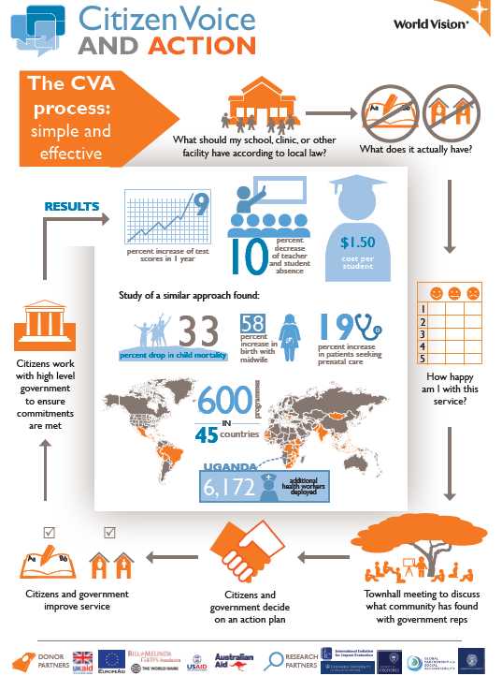
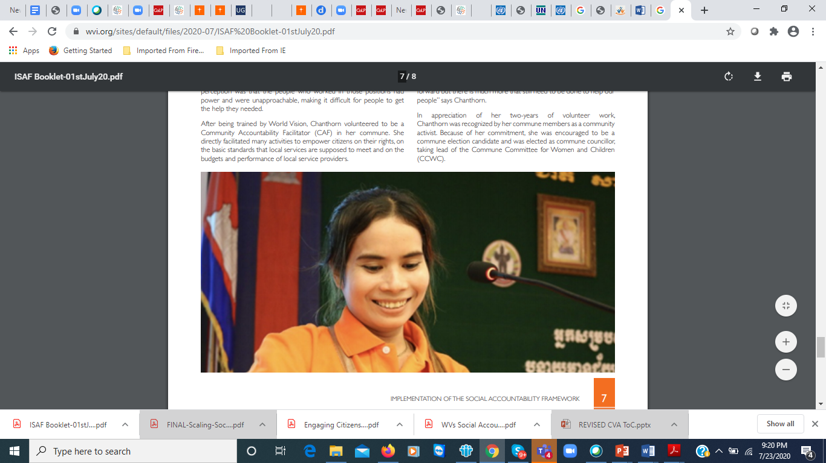
Accountability – who is the duty-bearer?
World Vision supports social accountability mechanisms in
48 countries
Notes:
https://www.wvi.org/publications/development-guide/cambodia/implementation-social-accountability-framework-booklet-01st
By mid 2020, World Vision International is implementing social accountability programmes in 48 countries across the world, improving services for millions of people through local dialogues. Our main global model for social accountability, Citizen Voice and Action, employs targeted civic education, participatory community services scorecards and social audits of services,
World Vision supports volunteers to hold the state to account. But NGOs are subjected to the same demands for better performance through social accountability practices.
A WV Field Staff in East Africa remarked - “They (the Citizen Voice and Action groups) were keeping us on our toes” by demanding for specific services. For example, the volunteers in Lolupe village sent a message to the Uajibikaji Pamoja online platform asking why World Vision was not providing mobile outreach services to communities around Nayuu dispensary. World Vision replied on the public platform explaining that the government had set up a static health facility to serve that community and therefore it wasn’t reasonable to run a mobile health outreach service in the same community
WVCambodia: Photo:
Chanthorn, 26, Community Accountability Facilitator in Phnum Srok district, Banteay Meanchey province, used to be unhappy with the services at her local health centre. Most people in her commune were uncomfortable engaging with commune administration services, the health centre or school for information or assistance. The common perception was that the people who worked in those positions had power and were unapproachable, making it difficult for people to get the help they needed. After being trained by World Vision, Chanthorn volunteered to be a Community Accountability Facilitator (CAF) in her commune. She directly facilitated many activities to empower citizens on their rights, on the basic standards that local services are supposed to meet and on the budgets and performance of local service providers. In appreciation of her two-years of volunteer work, Chanthorn was recognized by her commune members as a community activist. Because of her commitment, she was encouraged to be a commune election candidate and was elected as commune councillor, taking lead of the Commune Committee for Women and Children (CCWC).
WV’s Citizen Voice and Action model approach: EVPRA – over 3 years:
EVPRA focus on raising awareness and capacity building of ethnic minorities had a positive impact in creating self-confidence among the ethnic communities which was not visualised before starting of project activities. The project activities improved the capacity of lobbying, and advocating for SSNPs, and thereby increasing access to SSNP
Significant progress on social accountability and transparency made through awareness of public complaint/grievance redress mechanism which could be attributed to the establishment of complaint boxes
“Citizen Voice and Action” also utilises digital inventories of policies, services provided, based on information from citizens, social audits, etc – e.g. where community clinics in urban areas of the project despite being prioritised by the Govt. ,did not have running water - advocates can use the database to identify the most critical service delivery failures that are politically ripe. Advocates can use the information to identify the best opportunities for alliances among service providers and service users, and analyse particular regional or demographic-related gaps/ trends. Advocates can also use the information to highlight trends in the opinions of vulnerable groups. Through Action Item Monitoring in the CVA database or app – Reports can be generated that analyse the number of action items raised by communities in health, education etc public services & how many are addressed or Not. Majority of CVA activities take place at local/ community level with limited or no internet access. The mobile application was developed to enable end users to collect & analyze data in both offline & online mode. In over 11 countries ( Ghana, Senegal, Mali, Mauritania, Sierra Leone, Uganda, DRC ), Asia Pacific (Bangladesh, India, Indonesia, Philippines)
The World Bank estimates that cash and voucher transfers now account for over 50% of Government social protection mechanisms during this crisis. Most recent reports indicate that 190 countries scaled up existing social protection, especially social assistance transfer programmes as a result of the pandemic. Still, there has been limited focus on how social assistance and humanitarian cash and voucher transfers are programmed in complementarity, serving effectively all most vulnerable population demographics in a timely and quality service-fashion. Many governments struggle to provide the fastest and widest response to meet household needs through their own formal social protection system . In these instances, the most vulnerable groups, such as refugees and migrants, may not be able to access social protection, due to lack of legal documentation, or already marginalized groups (e.g. due to gender, level of education/ literacy, socio-economic status – like informal workers, people living with disabilities, people living in extreme poverty, etc.) are often simply being unaware of their right and therefore often inadvertently excluded from assistance that may aim to address their needs. Sometimes, Government policies are ill-implemented and de-facto do not target all sub-categories of most vulnerable groups. We are currently experiencing first-hand how this limited focus can result in immediate and dire impacts on vulnerable children, especially those living in fragile contexts.
These are some evidence points –we don’t need to reference them all but maybe some?
https://www.theigc.org/blog/covid-19-underscores-need-to-overhaul-social-policies-across-africa/
, Citizen Voice and Action, to ensure wider access of government safety nets to those in need, especially women and the most vulnerable. It was the first project of its kind to assist vulnerable community members, including ethnic minorities, to understand their entitlement to the social protection payments provided by the Bangladesh Government. Through social accountability facilitation, those receiving information about the safety nets to which they were entitled, including pensions, disability allowances and child-focused social assistance, increased from 15% at the start of the project to 83% at the end of the project. Target beneficiary numbers accessing the Government’s SSNP at the start of the project were as low as 5 %, whereas at the end 74% of beneficiaries had accessed and benefitted from the Governments SSNP due to Citizen Voice and Action community empowerment activities.The project demonstrates that even if government officials intend to reach the most vulnerable, they can often miss their intended target for relief due to administrative complexity or corruption. Ensuring the recipients of social protection have the information they need and a say in the relief reaching them guides government efficiency and effectiveness in resource allocation. The Government’s Social Protection Programmes’ scale up is currently also being complemented by World Vision Bangladesh’s Multipurpose Cash Assistance to address COVID-19 related needs. A total of US$ 538,488.3 was transferred via mobile money (bKash) to over 66,145 people in Bangladesh, benefitting 26,722 most vulnerable children in 14,699 households between April and June 2020 alone.

Slide 7


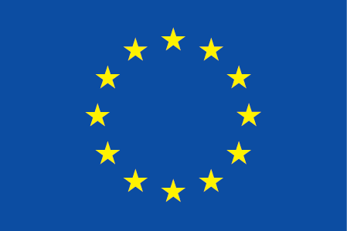
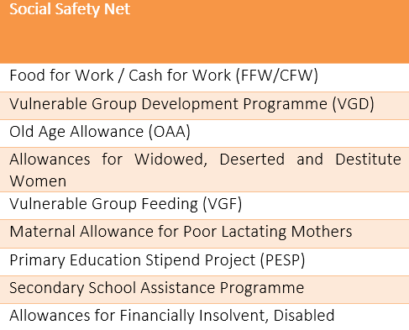
Social Protection Transfers by Governments – Social Accountability in Bangladesh
Accountability – who is the duty-bearer?
69% Increase
of vulnerable people to access
Government’s SSN entitlements
70% Increase
of vulnerable people receiving information about SSN pensions, disability and child/ students’ transfer assistance
WVI’s “Citizen, Voice and Action” – WVBangladesh, Pollisree & Pumdo – EU-facilitated EVPRA (Establishing Vulnerable Peoples’ Rights and Access to social safety net programmes ) Project – End of Project Evaluation data over 3 years (2017-2019)
Notes:
WV’s Citizen Voice and Action model approach: EVPRA – over 3 years:
EVPRA focus on raising awareness and capacity building of ethnic minorities had a positive impact in creating self-confidence among the ethnic communities which was not visualised before starting of project activities. The project activities improved the capacity of lobbying, and advocating for SSNPs, and thereby increasing access to SSNP
Significant progress on social accountability and transparency made through awareness of public complaint/grievance redress mechanism which could be attributed to the establishment of complaint boxes
“Citizen Voice and Action” also utilises digital inventories of policies, services provided, based on information from citizens, social audits, etc – e.g. where community clinics in urban areas of the project despite being prioritised by the Govt. ,did not have running water - advocates can use the database to identify the most critical service delivery failures that are politically ripe. Advocates can use the information to identify the best opportunities for alliances among service providers and service users, and analyse particular regional or demographic-related gaps/ trends. Advocates can also use the information to highlight trends in the opinions of vulnerable groups. Through Action Item Monitoring in the CVA database or app – Reports can be generated that analyse the number of action items raised by communities in health, education etc public services & how many are addressed or Not. Majority of CVA activities take place at local/ community level with limited or no internet access. The mobile application was developed to enable end users to collect & analyze data in both offline & online mode. In over 11 countries ( Ghana, Senegal, Mali, Mauritania, Sierra Leone, Uganda, DRC ), Asia Pacific (Bangladesh, India, Indonesia, Philippines)
The World Bank estimates that cash and voucher transfers now account for over 50% of Government social protection mechanisms during this crisis. Most recent reports indicate that 190 countries scaled up existing social protection, especially social assistance transfer programmes as a result of the pandemic. Still, there has been limited focus on how social assistance and humanitarian cash and voucher transfers are programmed in complementarity, serving effectively all most vulnerable population demographics in a timely and quality service-fashion. Many governments struggle to provide the fastest and widest response to meet household needs through their own formal social protection system . In these instances, the most vulnerable groups, such as refugees and migrants, may not be able to access social protection, due to lack of legal documentation, or already marginalized groups (e.g. due to gender, level of education/ literacy, socio-economic status – like informal workers, people living with disabilities, people living in extreme poverty, etc.) are often simply being unaware of their right and therefore often inadvertently excluded from assistance that may aim to address their needs. Sometimes, Government policies are ill-implemented and de-facto do not target all sub-categories of most vulnerable groups. We are currently experiencing first-hand how this limited focus can result in immediate and dire impacts on vulnerable children, especially those living in fragile contexts.
These are some evidence points –we don’t need to reference them all but maybe some?
https://www.theigc.org/blog/covid-19-underscores-need-to-overhaul-social-policies-across-africa/
, Citizen Voice and Action, to ensure wider access of government safety nets to those in need, especially women and the most vulnerable. It was the first project of its kind to assist vulnerable community members, including ethnic minorities, to understand their entitlement to the social protection payments provided by the Bangladesh Government. Through social accountability facilitation, those receiving information about the safety nets to which they were entitled, including pensions, disability allowances and child-focused social assistance, increased from 15% at the start of the project to 83% at the end of the project. Target beneficiary numbers accessing the Government’s SSNP at the start of the project were as low as 5 %, whereas at the end 74% of beneficiaries had accessed and benefitted from the Governments SSNP due to Citizen Voice and Action community empowerment activities.The project demonstrates that even if government officials intend to reach the most vulnerable, they can often miss their intended target for relief due to administrative complexity or corruption. Ensuring the recipients of social protection have the information they need and a say in the relief reaching them guides government efficiency and effectiveness in resource allocation. The Government’s Social Protection Programmes’ scale up is currently also being complemented by World Vision Bangladesh’s Multipurpose Cash Assistance to address COVID-19 related needs. A total of US$ 538,488.3 was transferred via mobile money (bKash) to over 66,145 people in Bangladesh, benefitting 26,722 most vulnerable children in 14,699 households between April and June 2020 alone.

Slide 8
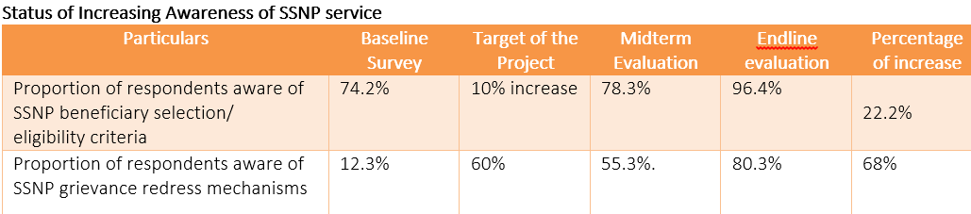
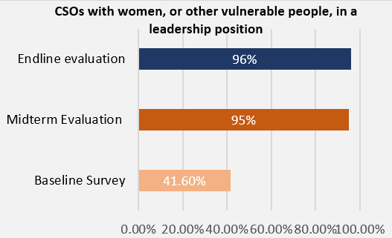
Social Protection Transfers by Governments – Social Accountability in Bangladesh
Local Actors - Increase Sustainability
of Inclusiveness & Transparency
End Line Evaluation:
96%
CSOs have women in leadership positions, including as President, Vice-President, Secretary and Treasurer (midterm value 95% and Baseline value was 41.6%)
WVI’s “Citizen, Voice and Action” – WVBangladesh, Pollisree & Pumdo – EU-facilitated EVPRA (Establishing Vulnerable Peoples’ Rights and Access to social safety net programmes ) Project – End of Project Evaluation data over 3 years (2017-2019)
Notes:
A Union Parishad (UP) Chairman/Member and during FGD with community people that after final selection, beneficiaries list was displayed in the display board at the Union Parishad to ensure accountability and transparency. However, some respondents during FGD mentioned that even if the list is not displayed, community members become aware of who is selected within their community. “The list is not always displayed at the Union Parishad. But we come to know from someone or other who is selected from our area to get the allowance, “said a beneficiary during FGD. The respondents also mentioned that community members can provide their opinions or complaints regarding selected beneficiaries if anyone is not eligible or if any eligible person is missing from the SSNP services whether it is the community member himself/herself or someone else. This reporting of the community members verifies that the EVPRA project has contributed to capacitate the community people through CSOs to raise their voice in case of any discrepancy of SSNP beneficiaries. “One person in our area was not poor. But he was selected for VGF. When we came to know, we went to the Chairman and protested. His name was crossed out from the list” said another beneficiary during FGD.
Terminology: Unions are the smallest rural administrative and local government units in Bangladesh. Each Union is made up of nine Wards. Usually one village is designated as a ward. There are 4,554 unions in Bangladesh. A Union Council (union parishads) consists of a chairman and twelve members including three members exclusively reserved for women. Union Parishads are formed under the Local Government (Union Parishads) Act, 2009.

Slide 9
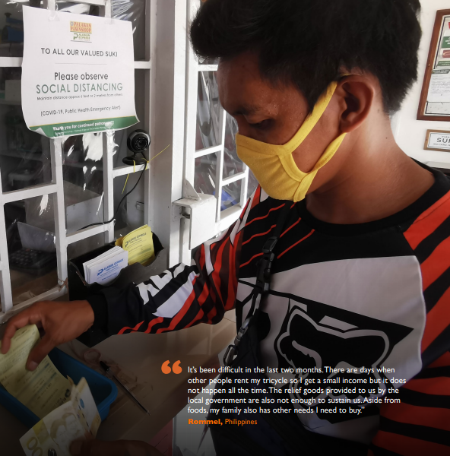
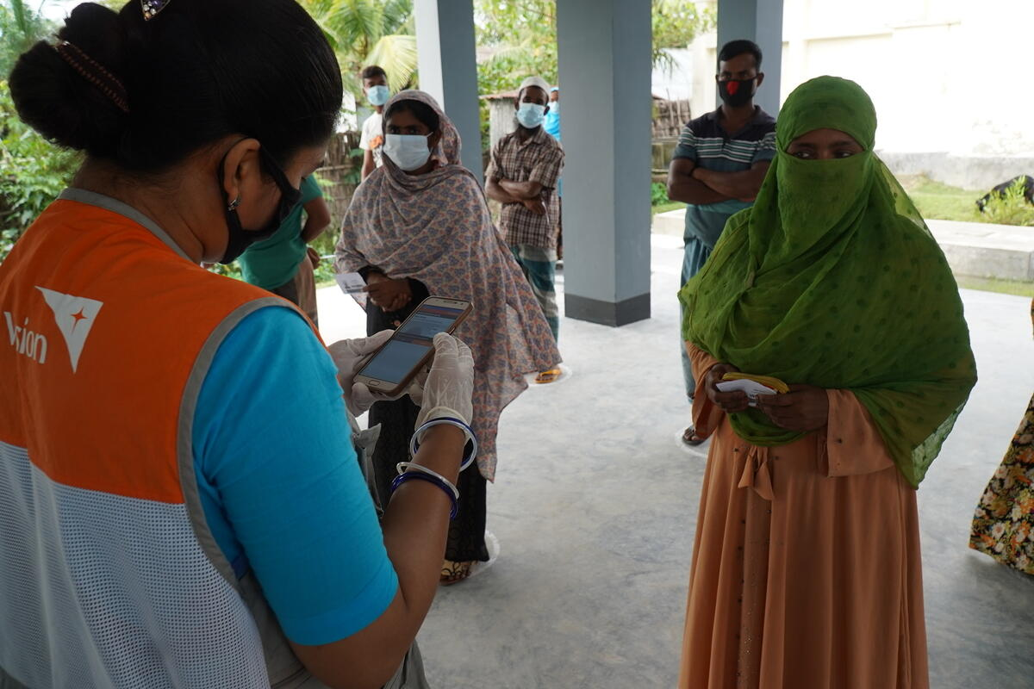
Strengthening Agility, Transparency, Synergy
in Transfer Assistance
World Vision’s Bangladesh MPCA - addressing COVID-19 related needs –
humanitarian accountability mechanisms underpin humanitarian transfer
US$ 538,488.3 was transferred via mobile money (bKash) to over 66,145 people in Bangladesh, benefitting 26,722 most vulnerable children in 14,699 households between April -June 2020
Coordination with local Government to ensure deduplication of targeted households, complementing Government’s Social Assistance Transfer Scale-Up
Can we, as “Cash/Voucher Assistance Community” also jointly scale up social accountability as an integral approach working with national actors?
Notes:
The World Bank estimates that cash and voucher transfers now account for over 50% of Government social protection mechanisms during this crisis. Most recent reports indicate that 190 countries scaled up existing social protection, especially social assistance transfer programmes as a result of the pandemic. Still, there has been limited focus on how social assistance and humanitarian cash and voucher transfers are programmed in complementarity, serving effectively all most vulnerable population demographics in a timely and quality service-fashion. Many governments struggle to provide the fastest and widest response to meet household needs through their own formal social protection system . In these instances, the most vulnerable groups, such as refugees and migrants, may not be able to access social protection, due to lack of legal documentation, or already marginalized groups (e.g. due to gender, level of education/ literacy, socio-economic status – like informal workers, people living with disabilities, people living in extreme poverty, etc.) are often simply being unaware of their right and therefore often inadvertently excluded from assistance that may aim to address their needs. Sometimes, Government policies are ill-implemented and de-facto do not target all sub-categories of most vulnerable groups. We are currently experiencing first-hand how this limited focus can result in immediate and dire impacts on vulnerable children, especially those living in fragile contexts.
These are some evidence points –we don’t need to reference them all but maybe some?
https://www.theigc.org/blog/covid-19-underscores-need-to-overhaul-social-policies-across-africa/
, Citizen Voice and Action, to ensure wider access of government safety nets to those in need, especially women and the most vulnerable. It was the first project of its kind to assist vulnerable community members, including ethnic minorities, to understand their entitlement to the social protection payments provided by the Bangladesh Government. Through social accountability facilitation, those receiving information about the safety nets to which they were entitled, including pensions, disability allowances and child-focused social assistance, increased from 15% at the start of the project to 83% at the end of the project. Target beneficiary numbers accessing the Government’s SSNP at the start of the project were as low as 5 %, whereas at the end 74% of beneficiaries had accessed and benefitted from the Governments SSNP due to Citizen Voice and Action community empowerment activities.The project demonstrates that even if government officials intend to reach the most vulnerable, they can often miss their intended target for relief due to administrative complexity or corruption. Ensuring the recipients of social protection have the information they need and a say in the relief reaching them guides government efficiency and effectiveness in resource allocation. The Government’s Social Protection Programmes’ scale up is currently also being complemented by World Vision Bangladesh’s Multipurpose Cash Assistance to address COVID-19 related needs. A total of US$ 538,488.3 was transferred via mobile money (bKash) to over 66,145 people in Bangladesh, benefitting 26,722 most vulnerable children in 14,699 households between April and June 2020 alone.

Slide 10
Grand Bargain Cash Workstream
Webinar Series
20-24 July, 2020
Thank you !
Data updated as of 31 December 2018

